Slide 1
Creative Financing, Complementary Financing
Ways For Farms to Acquire Capital for Start-up and Operations
Ben Waterman
UVM Extension New Farmer Project
Ben.waterman@uvm.edu, (802) 656-9142

Slide 3
Community Capital
Courtesy of Cornelia Flora, Iowa State University, Department of Sociology
Notes:
Financial capital can provide support for cultivating other forms of capital

Slide 4
Community Financing
Financial capital exchange directly between community members and small businesses within their communities
Notes:
A community can be defined in terms of geographics, or it can be a group of like minded individuals. A village is a community, as is a church group as is an internet chat forum. Community financing is usually provided by individuals.

Slide 5
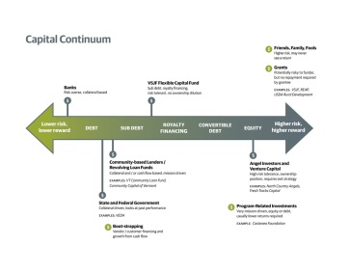
Social Impact
Images courtesy of Vermont Sustainable Jobs Fund, and Brian Dunn, Growth Capital Services, Inc.

Slide 6
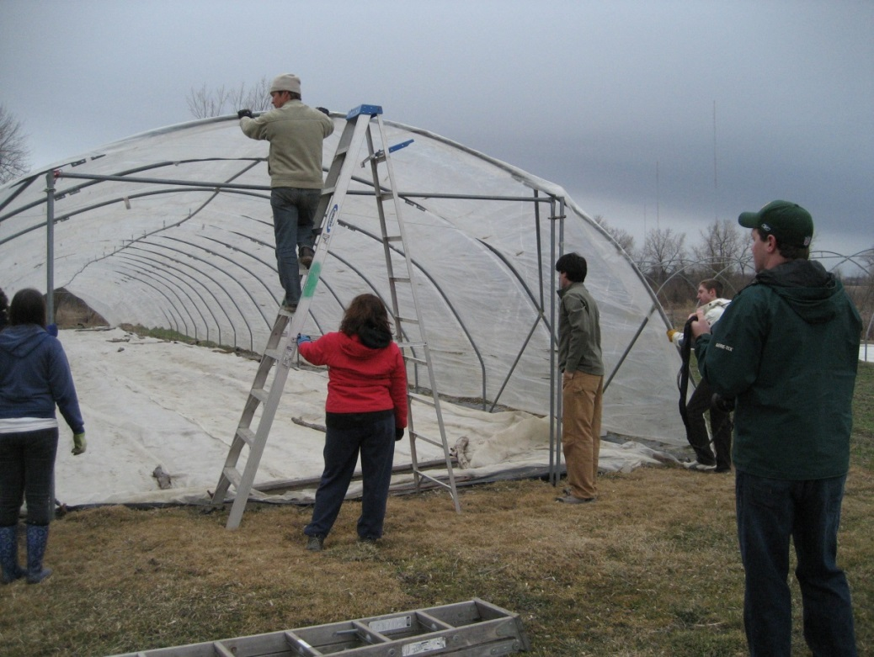
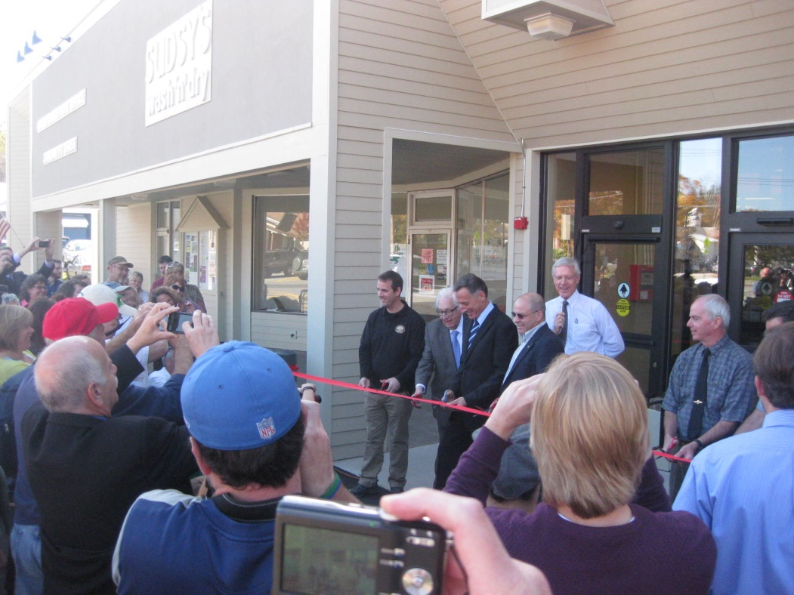
Community Supported Farm
A farm whose financial, environmental, social support comes from surrounding communities
Notes:
There is a wide spectrum of degrees of support, depending on the farm, time of year, etc. But generally, where there exists a community supported farm, there also exists a farm supported community.

Slide 7
? Alternative Financing? Creative? Unconventional? Community? Complementary?

Slide 8
Guide to Financing the Community Supported Farm
Securities regulations to consider
Owner Financed Sales and Land Contracts
Considerations for dealing with farmland investors
Share Lease
Promissory note
Multi year CSAs (Pre-buys)
Equity financing
Revenue-based financing
Full guide and downloadable chapters online at www.uvm.edu/newfarmer
Notes:
Already new edition needed with chapters on crowdfunding and fed and state programs such as the new markets tax credits and community development block grants

Slide 9
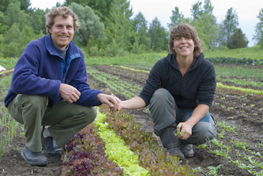
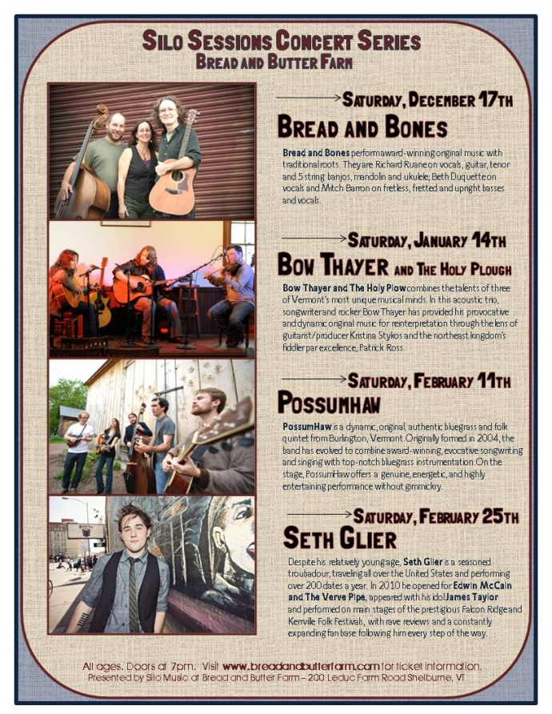
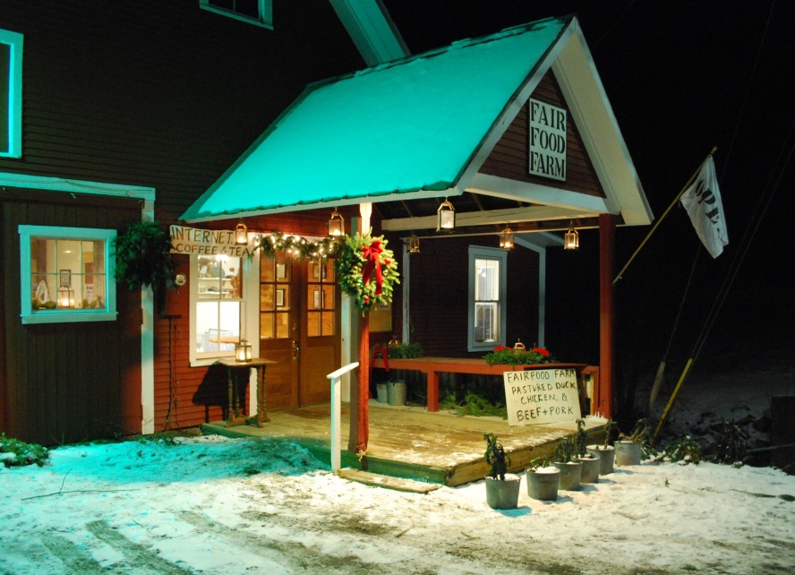
Partnering Farms

Slide 10
Owner-financed Sales
Notes:
One of the most common strategies for land acquisition, along with land contracts, share leases, and partnering with land trusts and/or farmland investors

Slide 11
Owner Financed Sales and Land Contracts
Key Considerations
What cash flow from on and off-farm income will be available to service the debt?
Amortization schedule, interest rate, purchase price and downpayment, balloon period -- ALL NEGOTIABLE
Licensed Lender laws for non-agricultural property
Promissory note and Mortgage deed are backbone legal docs
Treated as Installment Sales for tax purposes

Slide 12
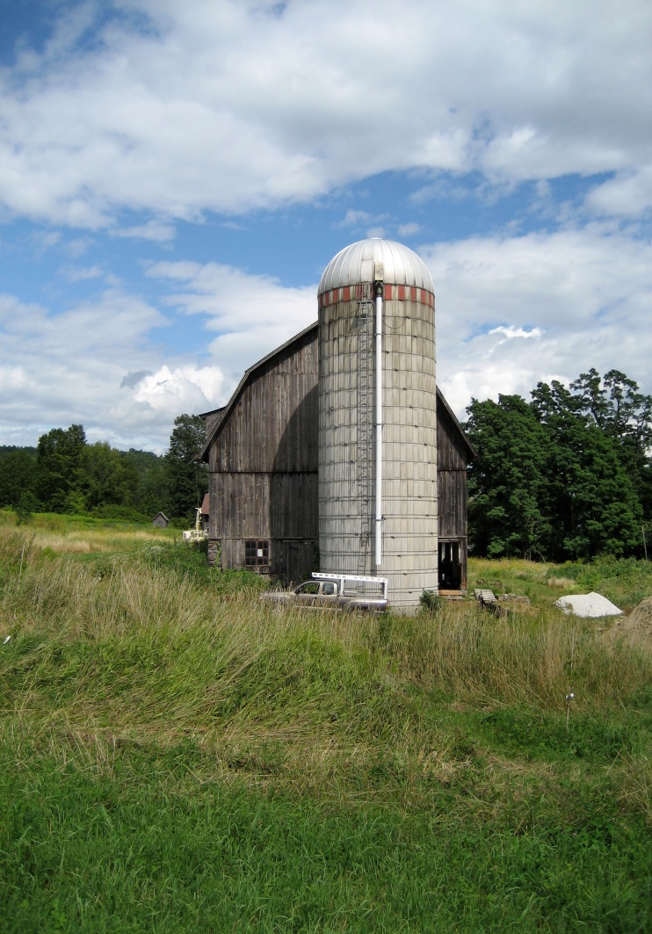
Owner-financed Sales
ADVANTAGES:
Can be very simple
Credit history, high credit score, high downpayment not always needed
Owner-seller earns interest income
Farmer gains full legal title
Flexibility can be incorporated
Notes:
The landowner acts as the bank to finance all or part of the sale of land to the farmer-buyer. Two main elements to document the arrangement: promissory note and mortgage deed.
Flexibility example 1 (good for farmer-buyer): 3 year deferred principal payment, interest only payment
Flexibility example 2: (good for owner-seller): 30 yr amortization with balloon payment at 5yr mark

Slide 13
Owner Financed Sale
DISADVANTAGES
Foreclosure still a danger
Interest rates might not be lower than in a conventional mortgage deal
Owner financing often not sufficient
Legal costs might be higher

Slide 14
Land Contracts
Full legal title not transferred until all payments are made
Full equitable title is assumed, giving farmer essentially most ownership rights
Owner-seller has more assurance
FSA now guarantees land contracts
See: http://www.fsa.usda.gov/Internet/FSA_File/lc_guarantee_program.pdf
Notes:
Often used within farm families, because senior gen has more control

Slide 15
Loans from Individuals

Slide 16
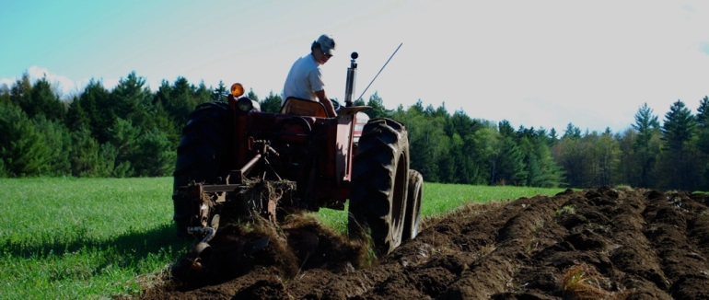
Loans from Individuals
Key Considerations
Gift vs Loan? Loan has distinct principal and interest. Refer to IRS Below Market Loan Rules to determine status and exemptions
Promissory note is the backbone legal doc
Interest rate, deferred payment period, payment schedule – ALL NEGOTIABLE
Notes:
Applicable Federal Rate

Slide 17
Loans From Individuals
Advantages:
Extremely Flexible
Can be simple
Keeps money in communities
Disadvantages:
Considerable time courting and maintaining relationships with lenders
Can be expensive to set up, e.g. accounting and legal fees

Slide 18
Multi-Year CSA Shares

Slide 19
Multi-Year CSA Shares
Key Considerations:
Not a loan, but a pre-purchase of goods and services.
Fixed benefits or discounts can be offered
Clear refund policy is important

Slide 20
Multi-Year CSA Shares
Advantages:
Good way to establish customer loyalty
Secure the CSA market
Can provide leverage for other loans
Disadvantages:
Taxed as income, not treated as loan principal
Careful business planning needed to reserve operating capital to meet production needs
Written CSA share agreements and legal assistance can be expensive

Slide 21
Share-Lease

Slide 22
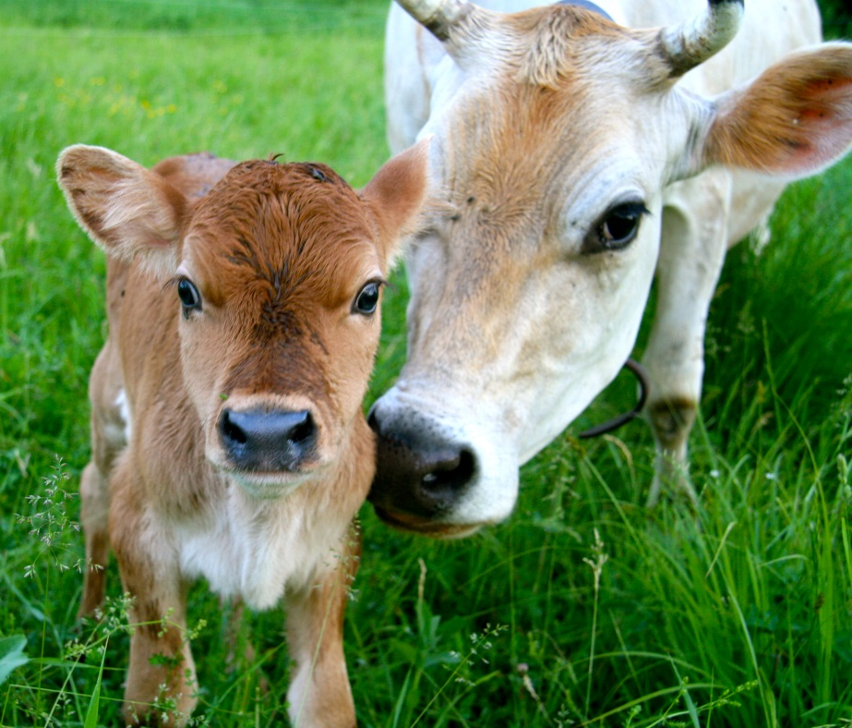
Share Leases
Key Considerations:
It is a lease, and all provisions of a lease should be understood, before talking about shared costs and revenues.
No shared ownership of assets. Not a legal partnership, but can be construed as one

Slide 23
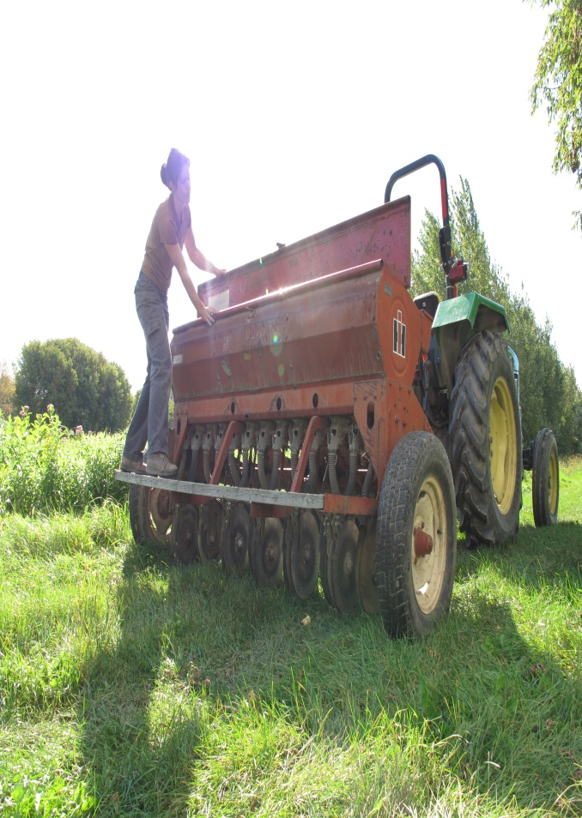
Share Lease
ADVANTAGES:
Allows farmer to put “sweat equity” to good use
Simple legal arrangement compared to a legal partnership
Allows farmer to build equity, good example is “sharemilking” where farmer-tenant owns bred stock
Can reduce farmer’s risk in unfavorable market conditions
Notes:
A share lease is a farm rental arrangement where the landowner and farm-tenant share costs of production and revenue and/or goods.

Slide 24
Share Lease
Disadvantages
Accounting and valuing contributions can be time-consuming and complicated
Land acquisition might still be out of the question
Farmer does not reap full benefits of sales during periods of favorable market conditions
Tax consequences can be blurry for the landowner depending on degree of “material participation”

Slide 25
Share Leases
Planning resources:
Developing Share Lease Agreements for Farmland.” Oklahoma Cooperative Extension Service. This workbook goes through detailed considerations in pursuing a share lease, and includes worksheets for determining costs and revenue sharing. Available online at: http://pods.dasnr.okstate.edu/docushare/dsweb/Get/Document-1778/AGEC-215web.pdf. Accessed online 2/15/2012.
A Sharemilking agreement is specific to dairying, and is a share lease that is focused on sharing dairy infrastructure and building equity for the tenant farmer through partial ownership of the herd or other assets. The University of Missouri Pasture-based Dairy Program has comprehensive resources on share-milking agreements for livestock operations. They are available online at: http://agebb.missouri.edu/dairy/grazing/sharemilking/. Accessed online 2/15/2012.
“Crop Share Rental Arrangements for Your Farm.” North Central Farm Management Extension Committee. This publication covers advantages and disadvantages of crop share arrangements, guiding principles used for developing equitable arrangements, and different approaches used for developing a functional arrangement. Available online at: http://www.aglease101.org/DocLib/docs/NCFMEC-02.pdf . Accessed online 2/15/2012.

Slide 26
Crowdfunding

Slide 27
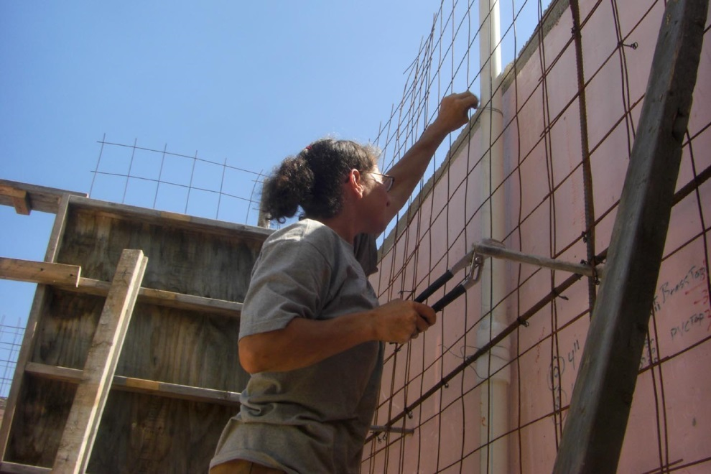
Crowdfunding
Works for innovative ideas and community oriented enterprises
For the farmer with social media and other tech skills
Notes:
Character types often span all three. Bottom line is open communication between farmer and farmland investor will expose exactly who has what expecations and goals, in order to determine if the arrangement is a realistic way to meet these goals.

Slide 28
Crowdfunding
Advantages:
Large sum of capital raised in short period of time
Builds community
Disadvantages:
Taxed as income? Time needed to distinguish gifts vs income
Significant amount of time needed to create a winning campaign

Slide 29
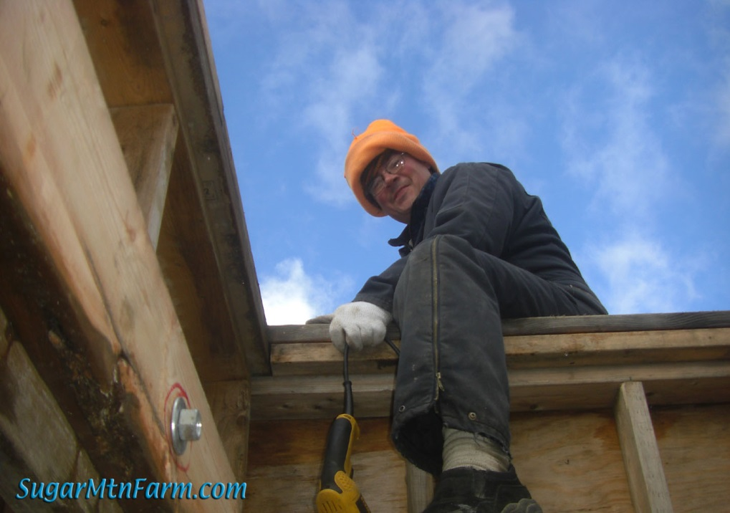
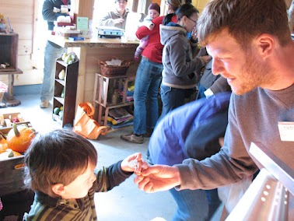
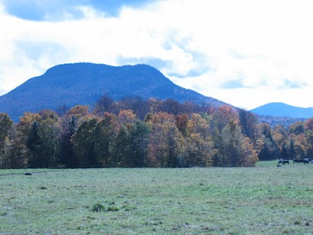

Slide 30
Closing Remarks
Creative financing can cut down hassle, paperwork, costs of capital. BUT:
An Advisory Team should be in place, including an attorney, tax adviser, and independent business counsel
For now public solicitation of investment is prohibited, and community financing happens on a private level.
Community financed farms create farm supported communities
Notes:
Simple in terms of cutting down on paperwork, and fine print

