Slide 1
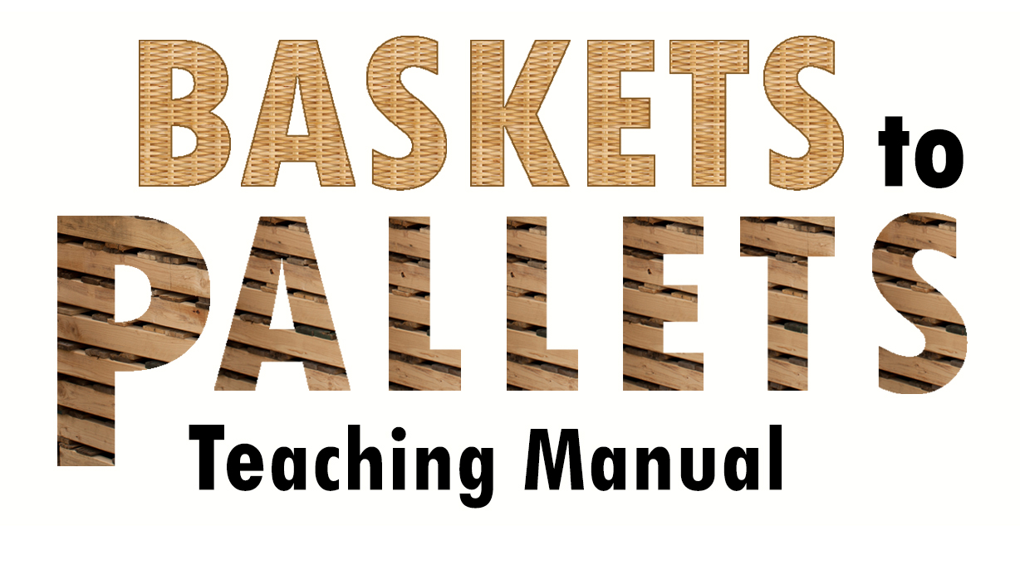
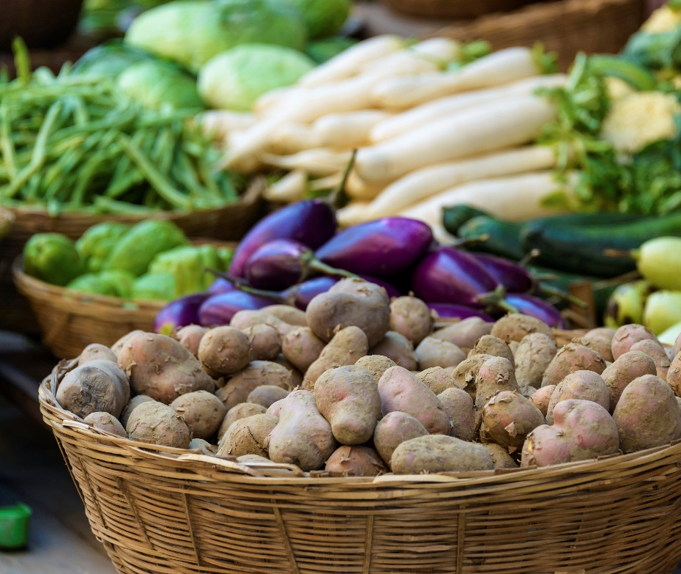
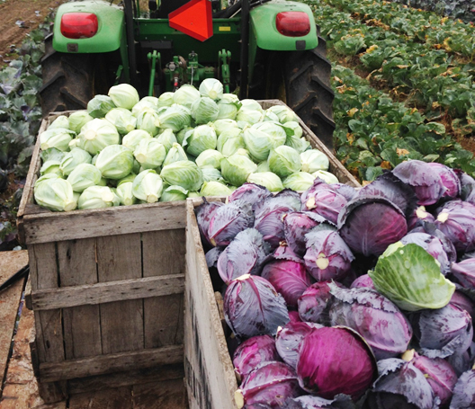
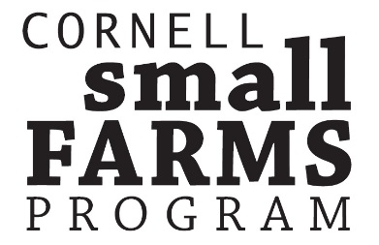
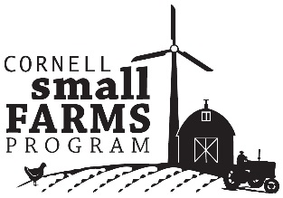
16 Lesson Plans to Prepare Small and Mid-scale
Farmers to Enter Food Hubs, Groceries, Restaurants and Cooperatives

Slide 2
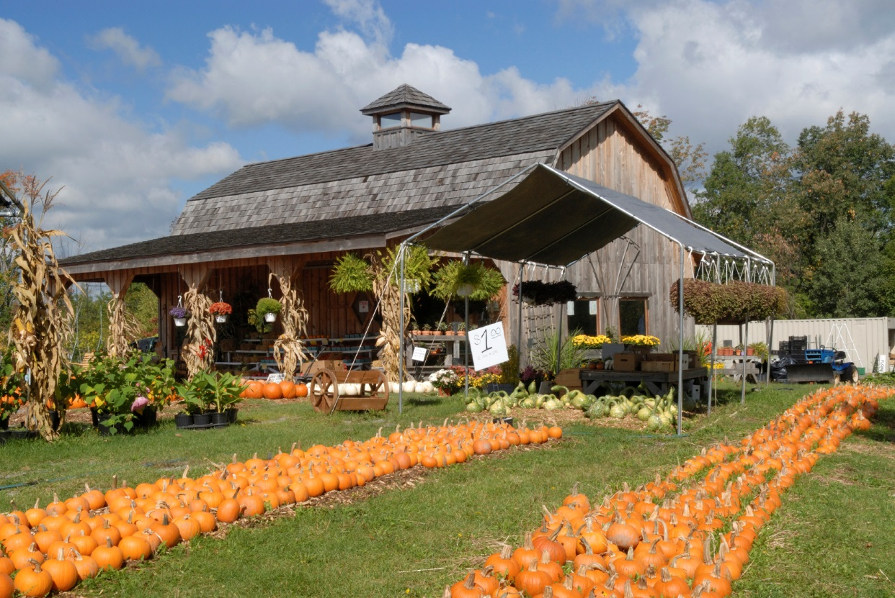
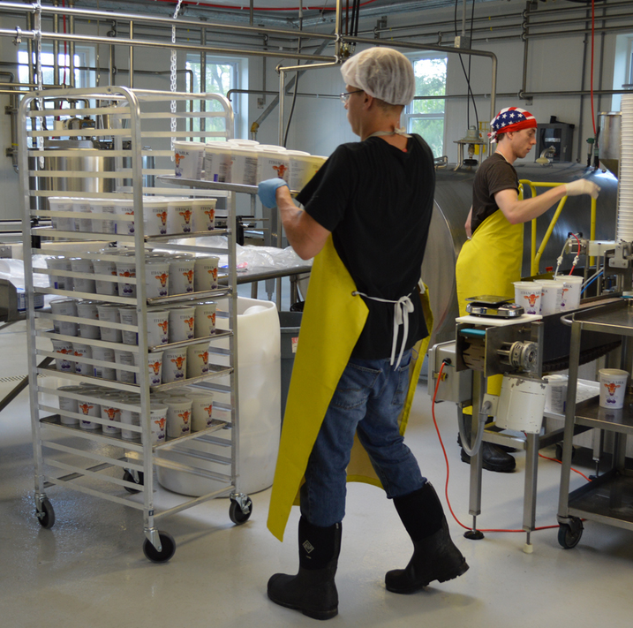
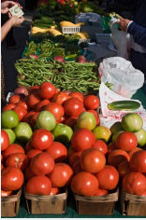
Unit 4.2 Recordkeeping This powerpoint presentation is a companion resource to the ‘Baskets to Pallets Teaching Manual’ available at smallfarms.cornell.edu Please see ‘Module 4-Production’ for additional teaching resources.
test

Slide 3
What are the most important records to keep?
-Production records
-what
-where
-when
-how much
-Financial records
-cost of production
-sales
-Food safety records
-inputs
-origins
-Farm health records
-crop rotations
-soil tests over time
Notes:
Remind people that you really can’t manage what you don’t measure.

Slide 4
How much does it cost to not know?
Notes:
Go through a few examples of what it costs not to know: Production example, food safety example, financial management example. Bean picker example: walk through the cost of labor to pick beans, the price of beans, and the price of a bean picker.

Slide 5
Production Records
Planting and seeding schedules
Harvest Schedules
Field maps

Slide 6
Available Programs
Farm Produce Manager
Ag Squared
Agrivi
Excel
Others?
Notes:
The key information that you want to be keeping track of is seeding dates, quantities, transplant dates, harvest dates, and harvest quantities. As you get bigger, tying this to location becomes more and more important. The programs are not listed in order of preference

Slide 10
Notes:
Being able to link field maps to records is one of the nice features of the more advanced ag software, as opposed to using programs like Excel.

Slide 12
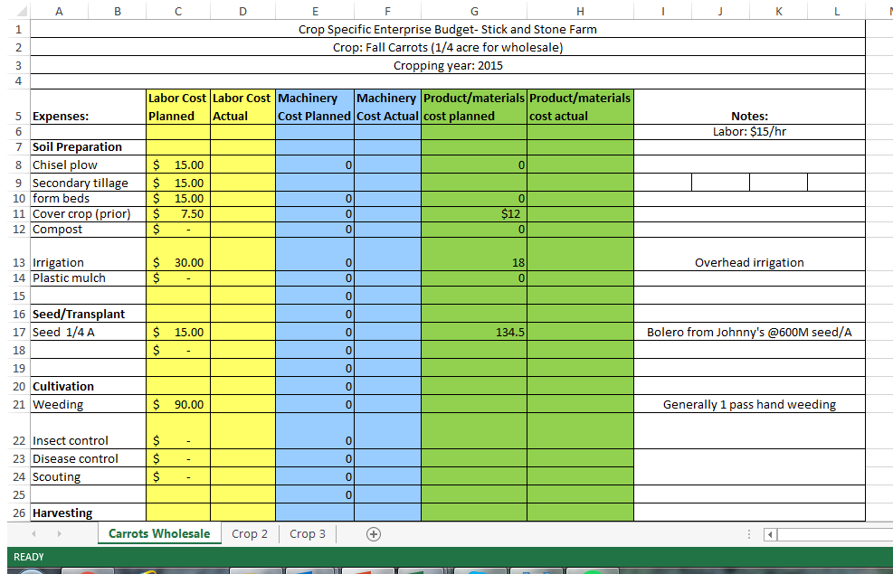
Financial Records
Cost of production
Sales

Slide 13
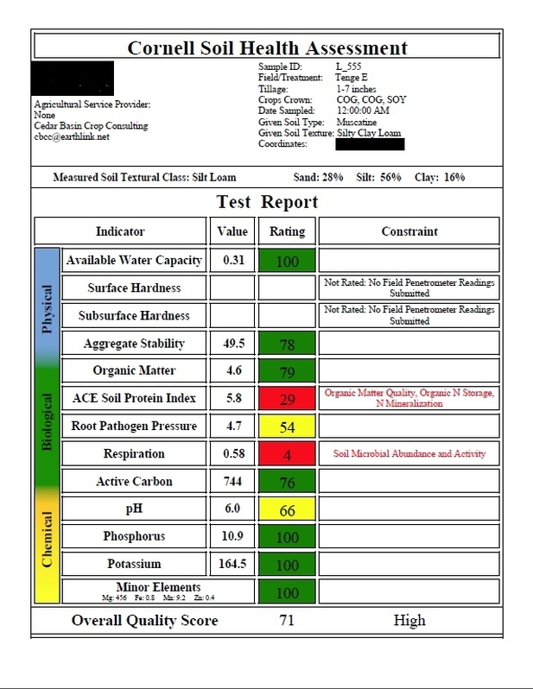
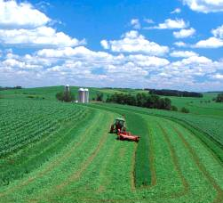
Record keeping for farm (and personal) health
Notes:
Crop rotations, soil health tests, soil tests. Also check in and make sure that the transition to wholesale is working with your life!

