Slide 1

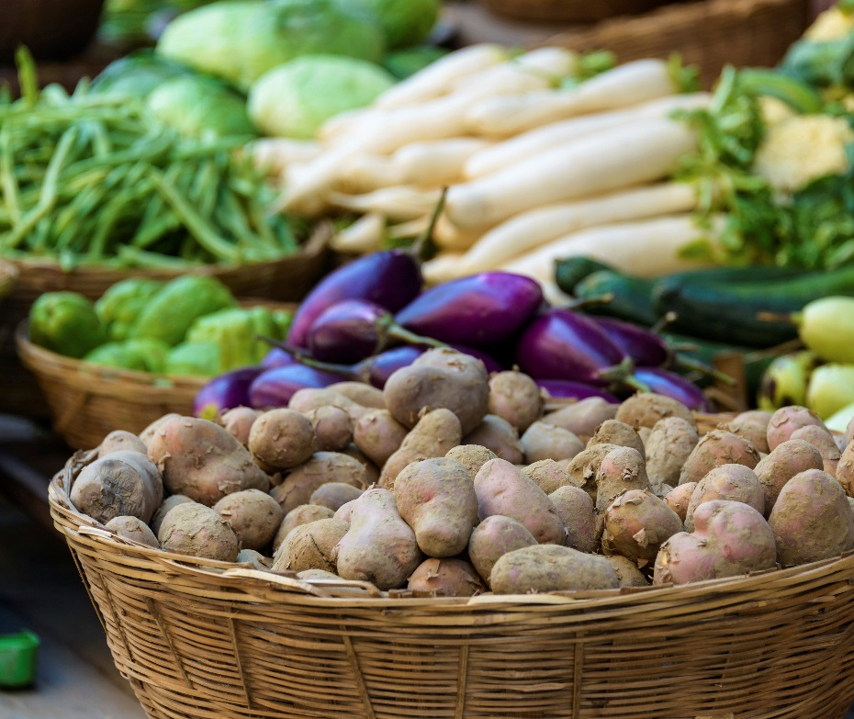
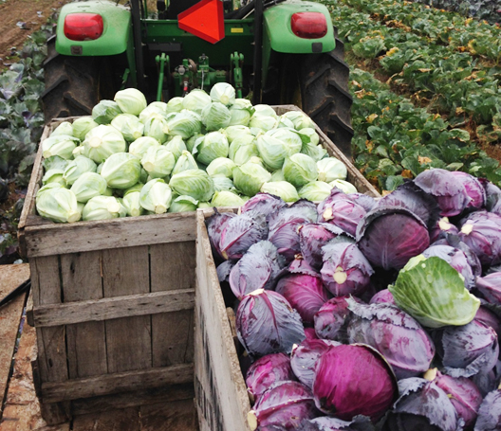




16 Lesson Plans to Prepare Small and Mid-scale
Farmers to Enter Food Hubs, Groceries, Restaurants and Cooperatives

Slide 2
Unit 4.2
Grading, Sorting, & Labeling
This powerpoint presentation is a companion resource to the ‘Baskets to Pallets Teaching Manual’ available at smallfarms.cornell.edu
Please see ‘Module 4: Production’ for additional teaching resources.
Notes:
The lecture focuses on collaborative marketing as a piece of your farm marketing strategy. Topics covered include: a compare and contrast of collaborative versus cooperative marketing, options for formal structures for collaborative marketing, obstacles to consider and success factors.

Slide 3
Production Module
Sorting, Grading and Labeling
  This activity will enable understanding of uniformity within wholesale vegetable production as well as wholesale livestock production. If the audience has both wholesale livestock and vegetable growers present split the group in two (at slide 13). You can combine the groups again at slide 29 or continue to keep them separate, this is up to the educator teaching the curriculum. The groups will use examples (pictures or actual product/labels) to learn uniformity when sorting grading and labeling

Slide 4
Why labels are important
  Specifies the style, size, and product you are selling
  Shows certain certifications if any
    May include: Organic, GAP certified, Pride of NY, USDA inspected
  Prevents the of spreading foodborne illness
    Provide traceability back to the farm

Slide 5
Labeling for Wholesale-Vegetables
Name of Farm and Address
  For farm trace back (GAP certified) the farmer can provide their own system of tracking
    Code usually made by the farmer. The code can display the pieces the farmer wants to show including date, product, plot number where it is grown, picking crew designation
    This type of labeling usually depends on the type of farm
Grade
  Examples
    Small Farm
      Sp619
      This would mean: Spinach picked on 6/19
    Large farm
      Sp619AAc3
      This would mean: spinach picked on 6/19 from field A section A by crew or person 3.
Quantity/Count
  Does the buyer specify a count. This depends on the vegetable/fruit.
    Example: Green Peppers: sold wholesale in 1 1/9 bushel boxes
Notes:
Labeling for value added-lettuce bags
Labeling the actual product-

Slide 6
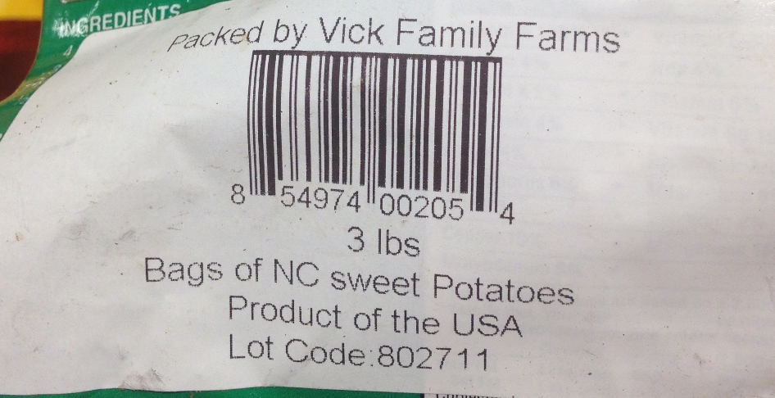
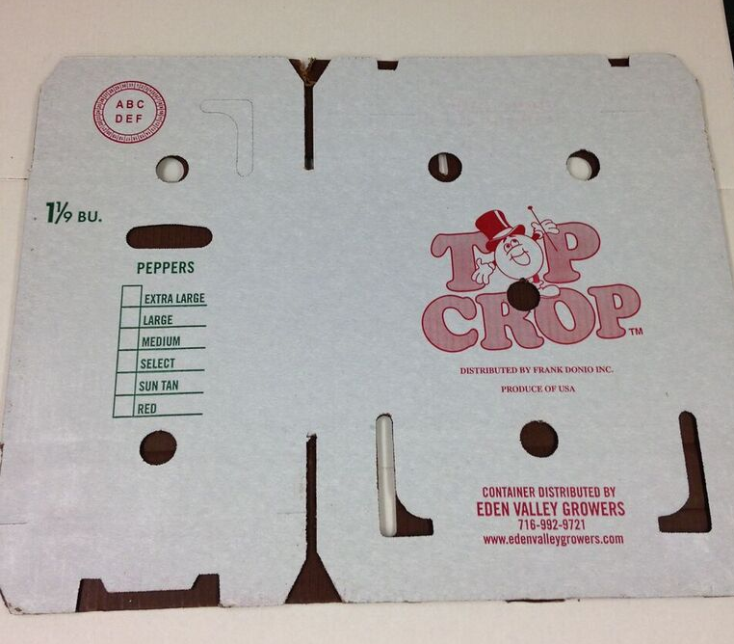
Example Label-Produce Box
Actual Sweet Potato Label
Example label on a 1 1/9 box of peppers that is
GAP certified
Picked on August 12th
From field 7
  Section A
Picking crew 2
Farm Address
Farm Name
Traceability
Grade
PEP8127A2
Address and Grower Name

Slide 7
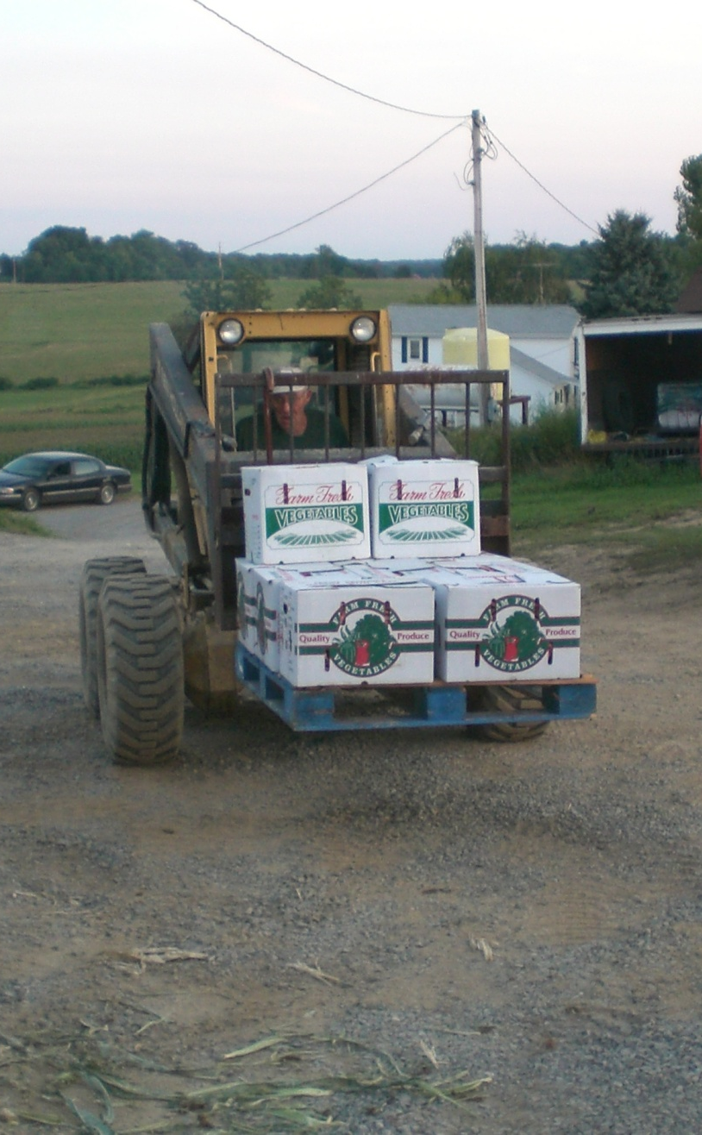
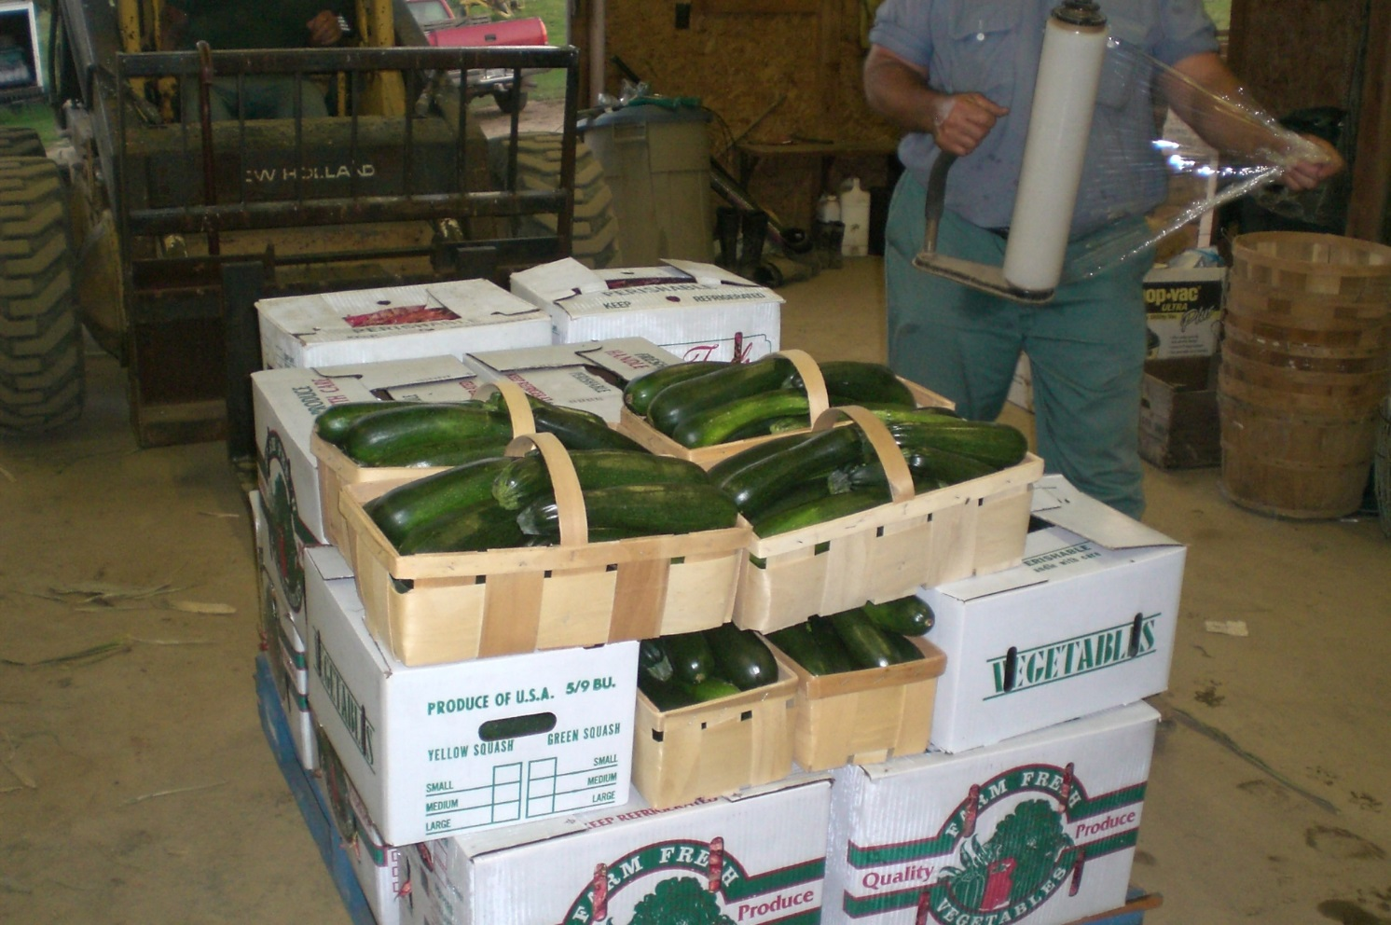
Wholesale Boxes
Notes:
Example of wholesale boxes stacked on a pallet for a wholesale outlet in Pittsburgh PA.

Slide 8

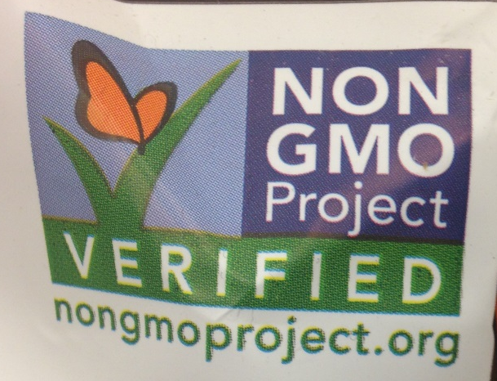
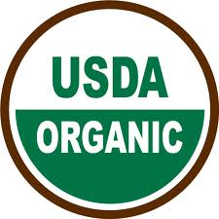
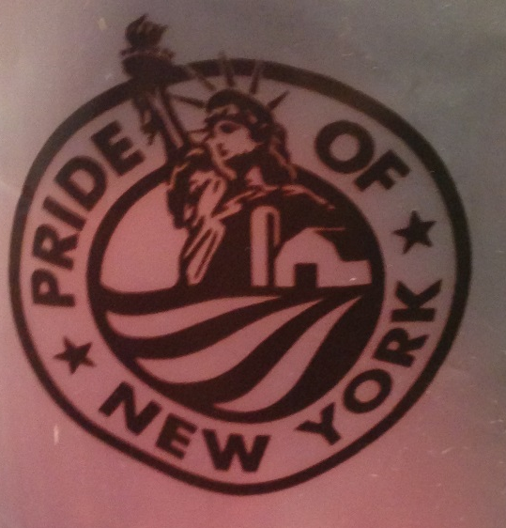
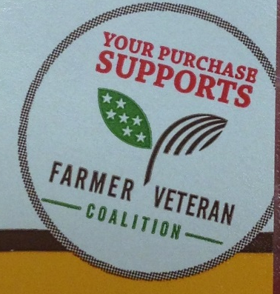
Wholesale Produce Labeling
Do not over-label
PLU or UPC codes
  Depends on who you’re selling to-some require this some do not
Statement of product identity
Indicate appropriate certifications
Farm Name and Address
Grade-If applicable

Slide 9

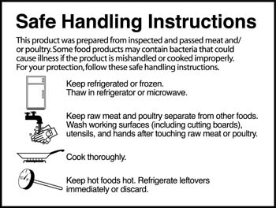
Labeling for Wholesale-Meat
USDA Inspection Sticker
Safe Handling Instructions
Farm Name
Address
Picture Credit: USDA

Slide 10
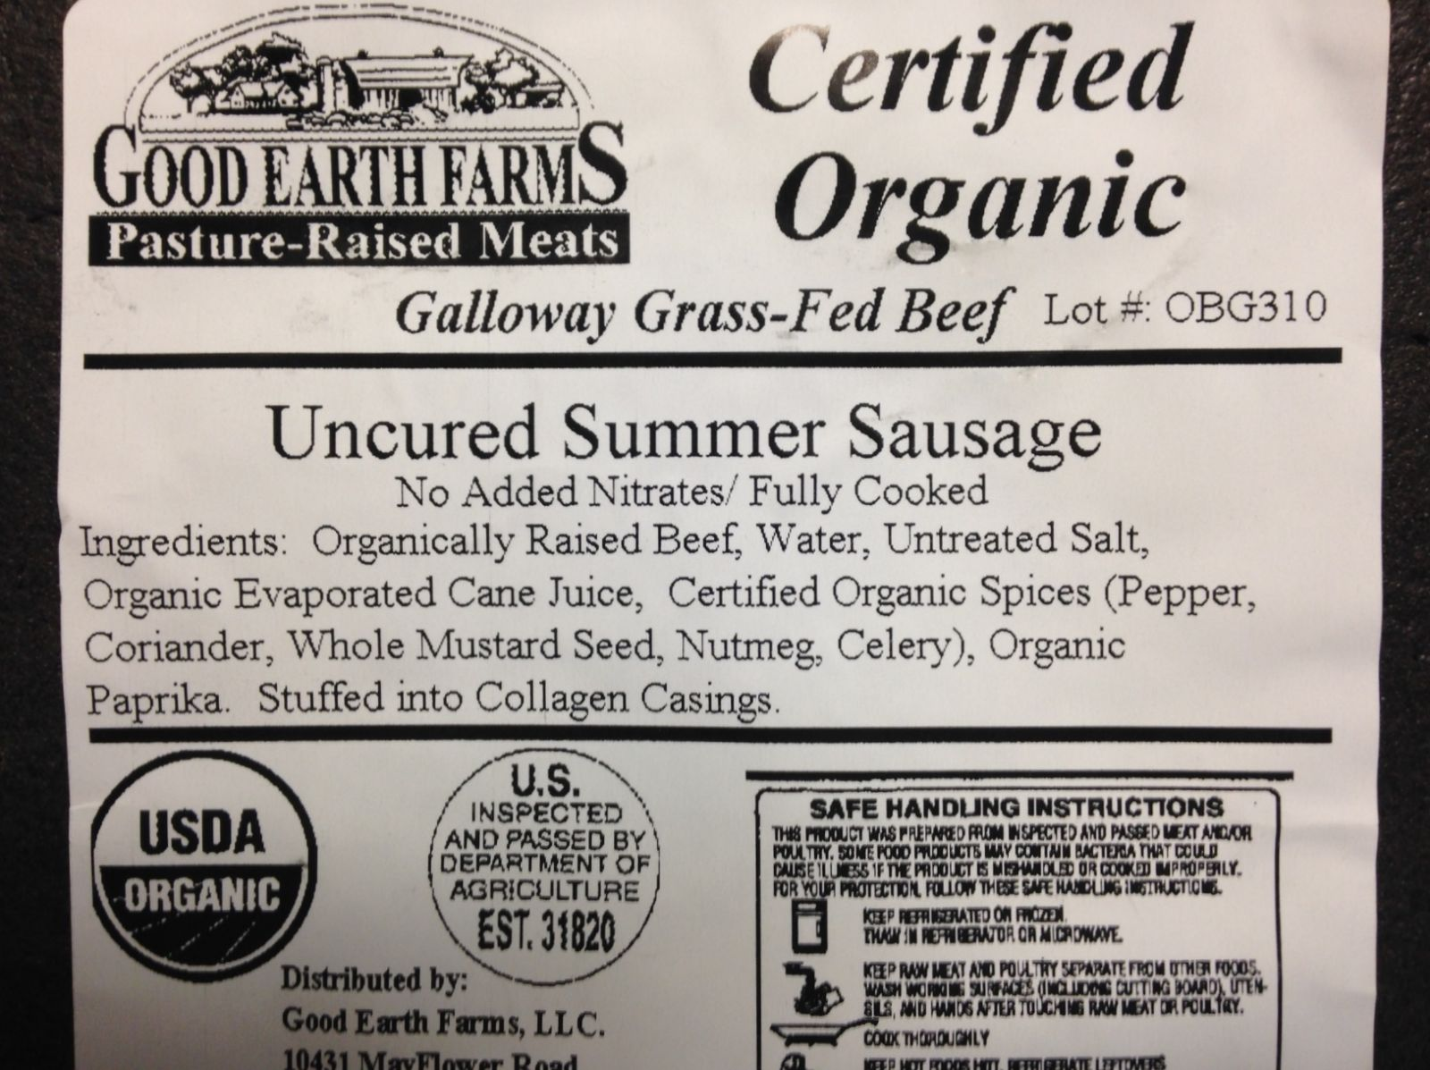
Example Label-Meat
Farm Name
Safe Handling Instructions
USDA inspection Sticker
Picture Credit: Good Earth Farms LLC

Slide 11
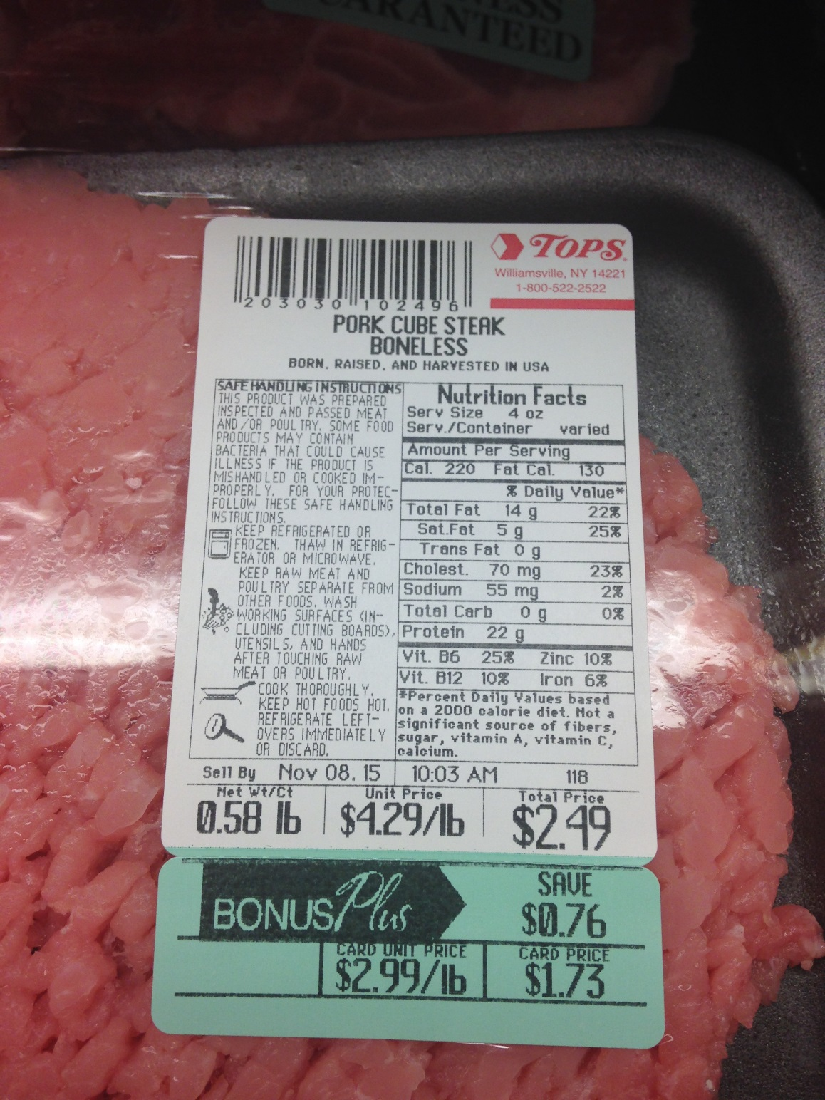
Labeling-Meat Products-Packaged
Labels for Packaged meat products have to have up to eight features with specific information including:
Product Name
USDA Inspection Legend
Net Weight
Handling Statement
Ingredients Statement
Nutrition Facts
Safe Handling Instructions

Slide 12
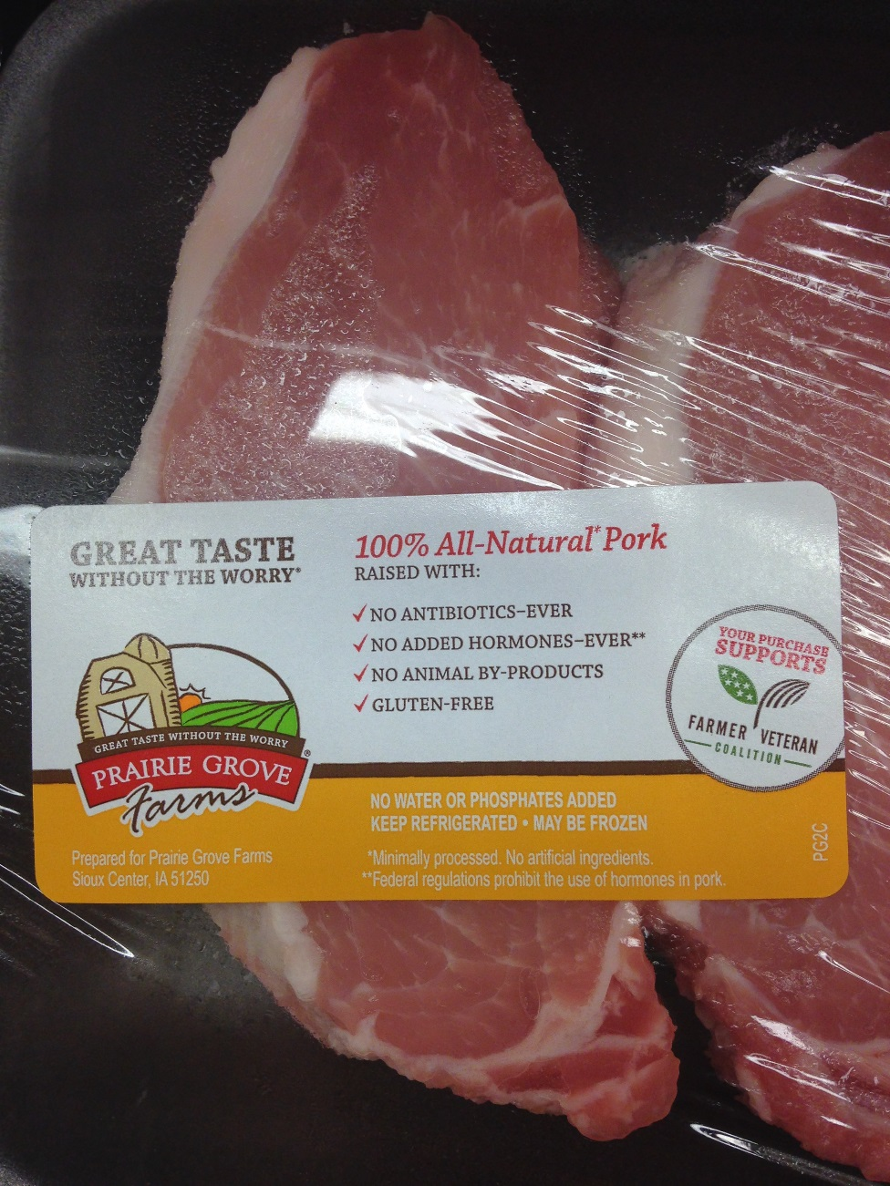
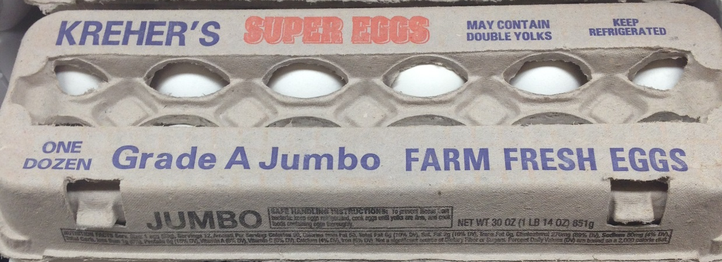
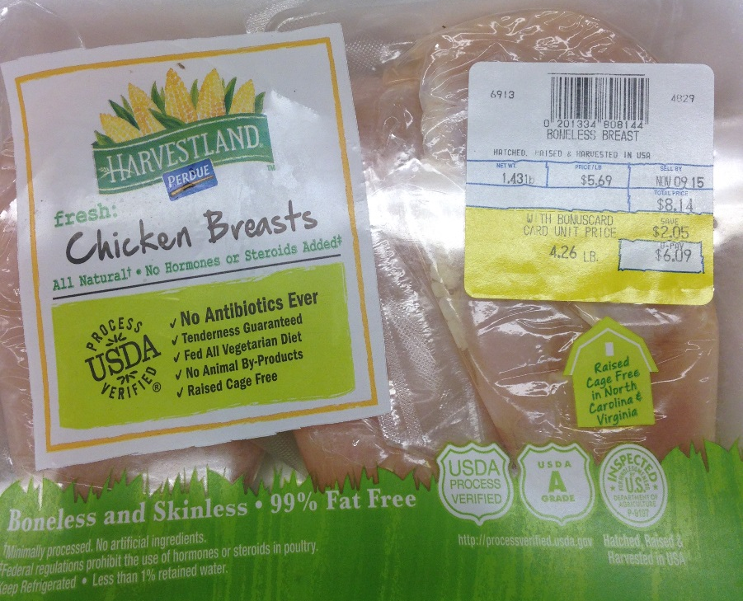
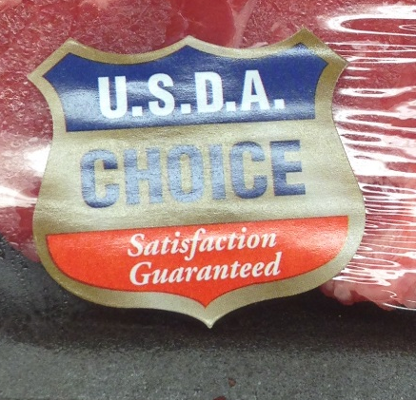
Other Labeling
Sample Label for animal products

Slide 13
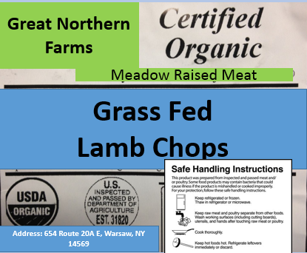
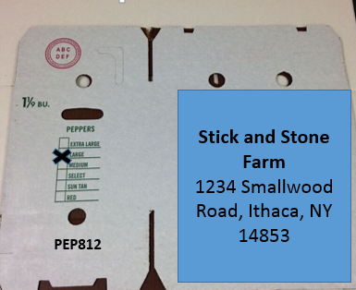
Label Making Activity
Make a label with the correct information for
A box of USDA inspected, certified organic, grass fed lamb chops. (Not for Resale if not USDA inspected) from Great Northern Farm/Meadow Raised Meats (address: 654 Route 20A E, Warsaw, NY 14569)
A GAP certified 1 1/9 bushel of large green peppers picked on August 12th from Stick and Stone Farm (address: 1234 Smallwood Road, Ithaca, NY 14853)
Notes:
If time allows the participants can make a label- educator can refer to the label making activity resource in the production module to get a better overview

Slide 14
Grading
For this section you have the option to break up the group if you have meat and vegetable producers in the same group

Slide 15
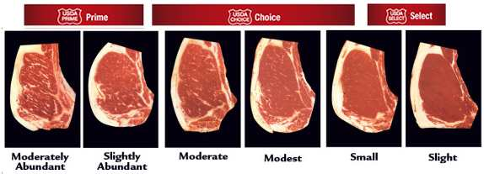
Why is grading important
Vegetables
  Different grades mean different quality and sizes; can be used for different products
    peppers
Animals
  Grades of meat
    Marbling. Established by the USDA
  Based on the meat product

Slide 16
Meat
Grading Meat

Slide 17
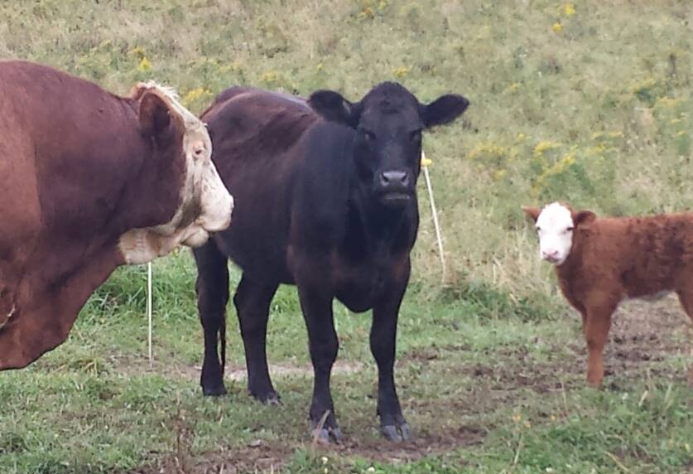
Meat Grading
Beef
  https://www.youtube.com/watch?v=tEHwm1gIj-w (6:38-11:00)

Slide 18
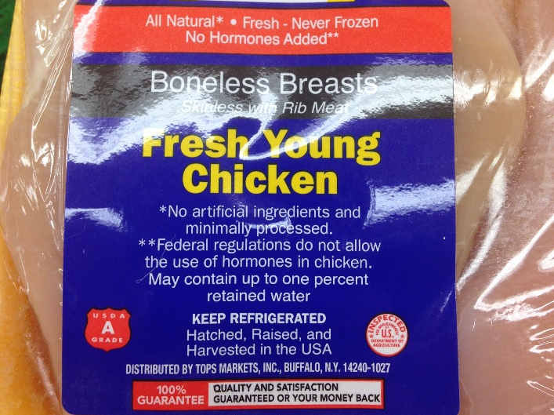
Meat Grading
FACTOR | GRADE A | GRADE B | GRADE C
Exposed Flesh | total length of cuts on breast or legs must be less than 1/4" and total length of cuts everywhere else must be less than 1 1/2" | 1/3 of the flesh on a part may be exposed | More than 1/3 of the flesh on a part may be exposed
Disjointed or broken bones | None or one disjointed | Two disjointed OR One disjointed and one non-protruding broken OR One non-protruding broken | No limit
Missing parts | Wing tips and/or tail removed at base | Wing(s) to 2nd joint AND/OR back area removed up to one-half way to the hip joint, not wider than base of tail | Back area not wider than base of tail extending to area beyond halfway to hip joints
Poultry
Notes:
Source: USDA

Slide 19

Meat Grades
Pork (according to the USDA)
  Pork is not graded in the same way that beef is graded. Basically, there are two types of pork – butcher hogs and sows. Butcher hogs are raised specifically for slaughter. They are bred to produce highly palatable meat. Sows are used to breed more pigs. When the sows are later slaughtered, their meat lacks palatability and therefore the meat is used for processed and cured pork such as sausages and hams (C&C Butcher)
  Pork is not graded with USDA quality grades as it is generally produced from young animals that have been bred and fed to produce more uniformly tender meat.
Notes:
Source:USDA

Slide 20
More info
For more information about meat grades go to:
  http://www.fsis.usda.gov/wps/portal/fsis/topics/food-safety-education/get-answers/food-safety-fact-sheets/production-and-inspection/inspection-and-grading-of-meat-and-poultry-what-are-the-differences_/inspection-and-grading-differences/!ut/p/a1/jZFRT4MwEMc_DY9di8yF-UZIzIYOXBYd42Xp4FpIoCVtkcxPb8EHnRm69qV39_tf2__hDKc4E_S94tRUUtB6iLPFkWzJwl2GJEqW7iNZx2_b5CkMib-7t8DhDyD2btRPrID8p49uuOBObcINx1lLTYkqwSROORhEhe5BaZwyKQukKQNzRozmBukSwNhCq2TR5YMVFi6sVLcwhjj9Po8lrmhRCY4kQw1QM-Za2dVGnVFfDgkFyJSAiooxUCBy0MfJLj8gvMfZ5ReJa_c69nbzVRR7JJn_Bq7M4AuYNtm6yGt5Ggd-CMTJ861dCoZHqFmnbLo0ptUPDnFI3_czLiWvYZbLxiHXJKXUBqeXJG6b1_TjOViR6qXZ-zr4BEpuht4!/#9
Notes:
Print the information sheets from the USDA website: http://www.fsis.usda.gov/wps/portal/fsis/topics/food-safety-education/get-answers/food-safety-fact-sheets/production-and-inspection/inspection-and-grading-of-meat-and-poultry-what-are-the-differences_/inspection-and-grading-differences/!ut/p/a1/jZFRT4MwEMc_DY9di8yF-UZIzIYOXBYd42Xp4FpIoCVtkcxPb8EHnRm69qV39_tf2__hDKc4E_S94tRUUtB6iLPFkWzJwl2GJEqW7iNZx2_b5CkMib-7t8DhDyD2btRPrID8p49uuOBObcINx1lLTYkqwSROORhEhe5BaZwyKQukKQNzRozmBukSwNhCq2TR5YMVFi6sVLcwhjj9Po8lrmhRCY4kQw1QM-Za2dVGnVFfDgkFyJSAiooxUCBy0MfJLj8gvMfZ5ReJa_c69nbzVRR7JJn_Bq7M4AuYNtm6yGt5Ggd-CMTJ861dCoZHqFmnbLo0ptUPDnFI3_czLiWvYZbLxiHXJKXUBqeXJG6b1_TjOViR6qXZ-zr4BEpuht4!/#9

Slide 21
Vegetables
Grading vegetables

Slide 22
Vegetable Grading
Vegetables
  The USDA has set standards for grading vegetables.
    #1-Highest Quality
    #2-Lower Quality often used in processing
    Culls-composted, not sold
  Sometimes the grades depend on the vegetables
    It is best to refer to the USDA or wholesale market to know what grade names they use

Slide 23
Why Grade Vegetables?
Specifies quality
Shows the buyers that the product has gone through a review process by skilled graders
Specifies size

Slide 24
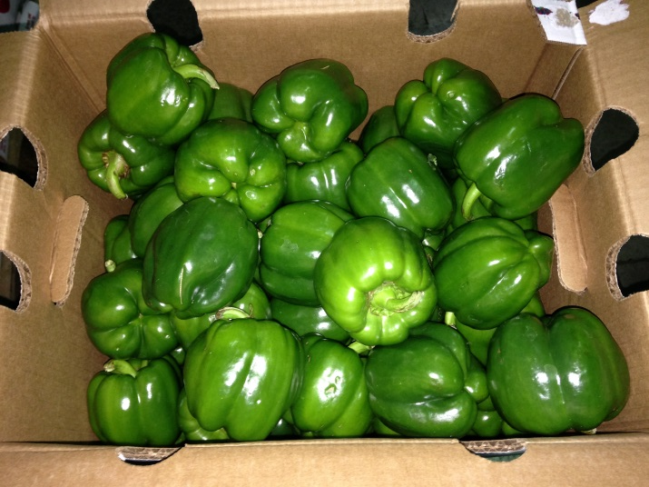
Grading Vegetable Example
Sweet Peppers

Slide 25
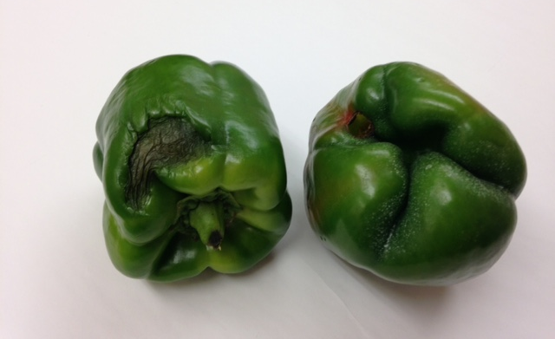
Sweet Peppers example
Culls
  Sorted out and composted

Slide 26
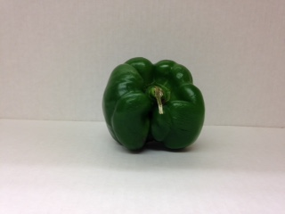
Sweet Peppers
Choppers or #2’s
Sorted out and often sold to canneries/processing or lower end grocery

Slide 27
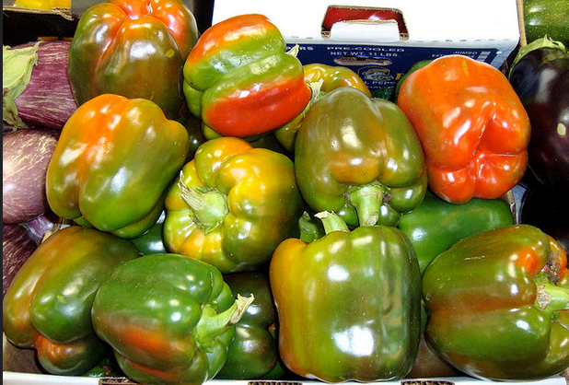
Sweet Peppers
Suntan
  Sorted out if they have color, sold separately from their all green pepper counter parts

Slide 28
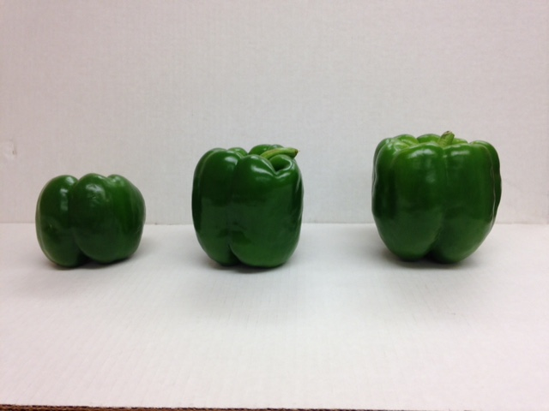
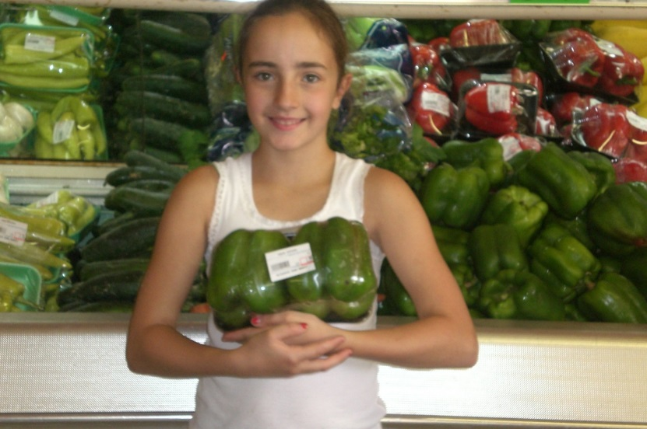
Sweet Pepper sizes-#1
Medium
Large
XL
Jumbo

Slide 29
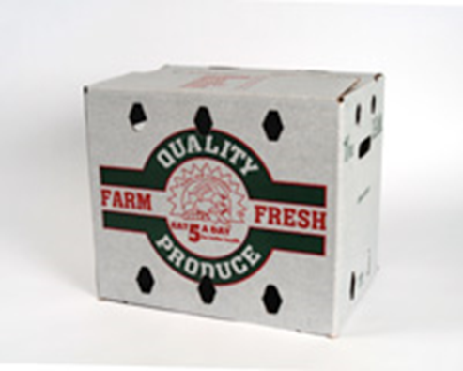
Pepper Boxes
Different wholesale buyers expect peppers to be in the boxes they specify. It is important to know what your wholesale buyer expects

Slide 30
Headwater Food Hub and Fisher Hill Farm: Expectations, Quality and Packaging
https://www.youtube.com/watch?v=GWMKBF7ExO0&feature=youtu.be

Slide 31
Buyers Specifications
NY State

Slide 32
Things to remember
The buyer has an option to buy or deny a product based on the grade, packaging and label
Be sure you know who your buyer is and if they specify certain requirements
If you plan on selling through a distributor ask if they have different requirements
Restaurants are often not as “picky” as grocery or distributors.

Slide 33
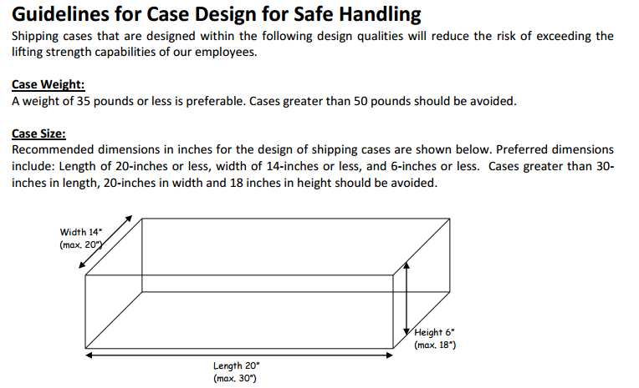
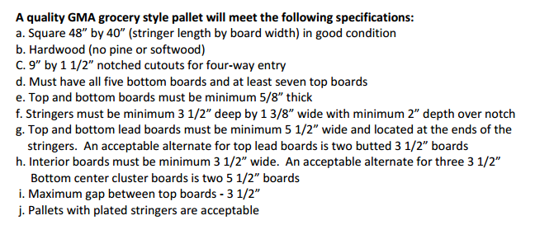
Buyers
Some wholesalers have standards on package size, weight, and pallet stacking.
  Example: Wegmans
Photo Credit: http://www.wegmans.com/pdf/forOurSuppliers/guidelinesForCaseDesign.pdf
Photo Crrdit: http://www.wegmans.com/pdf/forOurSuppliers/palletPolicy.pdf

Slide 34
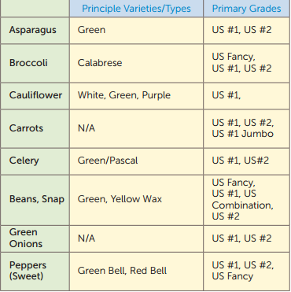

Example Grading Requirements for Produce
Example: Sysco
Source: http://www.localcrop.com/ordereze/Files/Sysco_Produce_Product_Catalog_compressed.pdf

Slide 35
Packaging

Slide 36
Importance of Packaging
In order to sell the product successfully at the Wholesale outlet the product must look
  Neat
  Quality
  Organized
  Full (with minimal settling over shipping)
  “yellow bellies” down
  Meet weight requirements if they are specified
  Stored at the right temperature (Especially Meat)

Slide 37
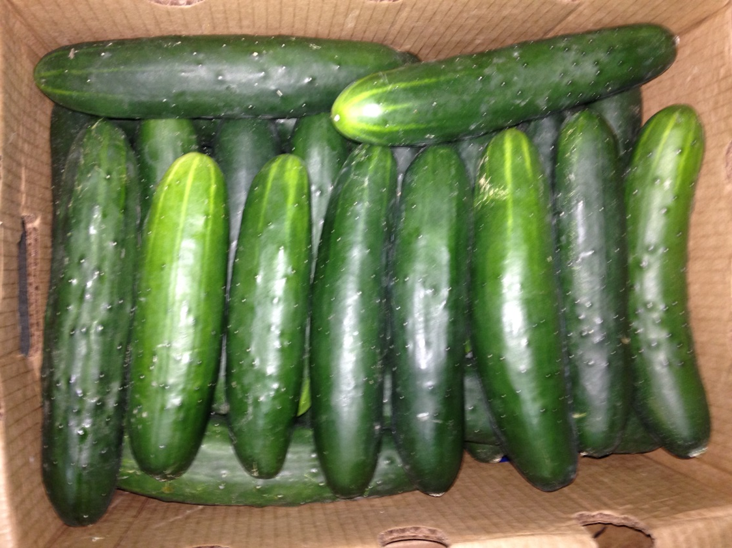
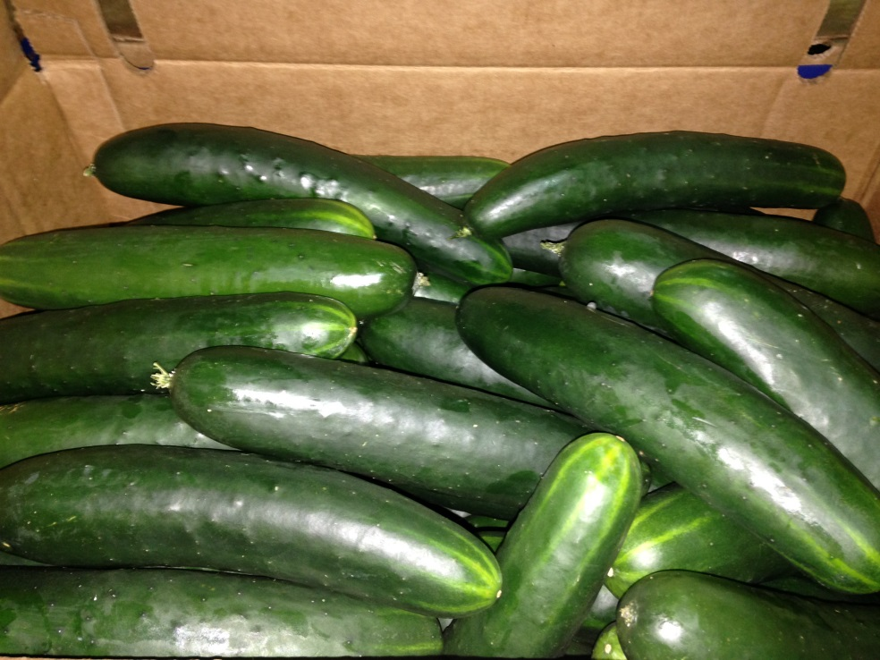
Packaging Examples in wholesale
No
Yes
Notes:
Neat and organized box of cucumbers

Slide 38
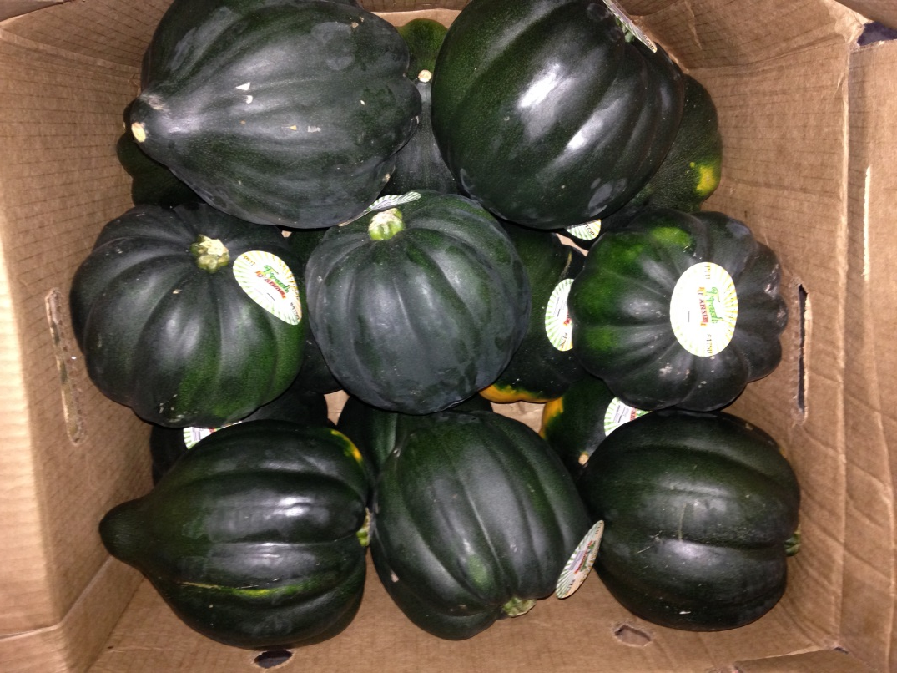
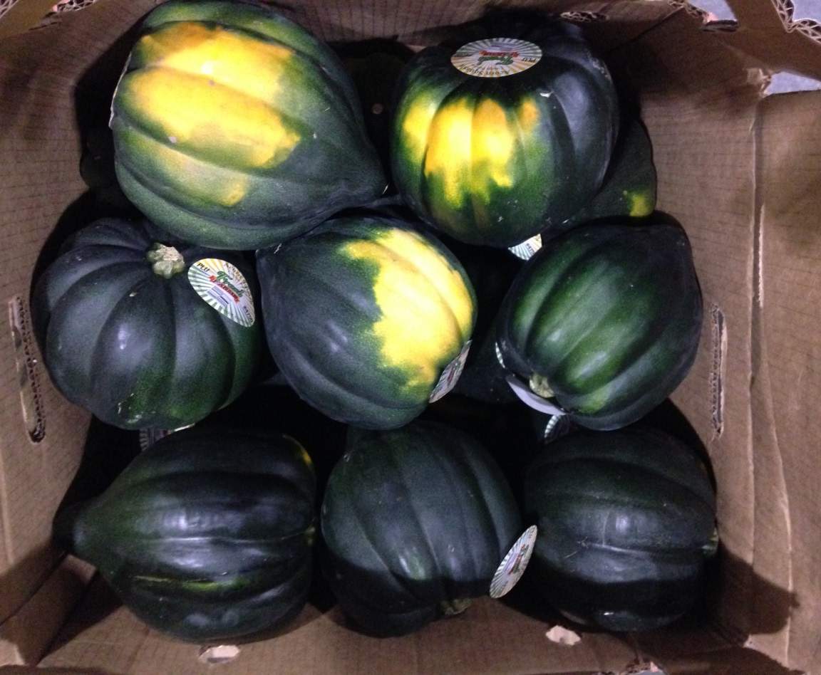
Packaging Examples in wholesale
No
Yes
Notes:
Yellow bellies down

Slide 39
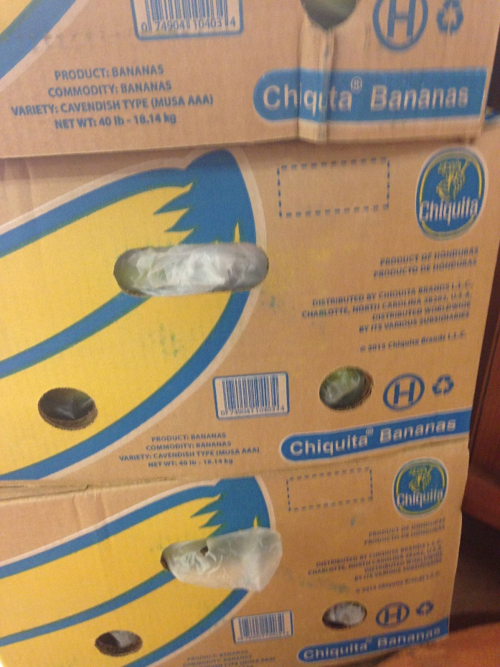
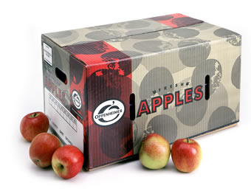
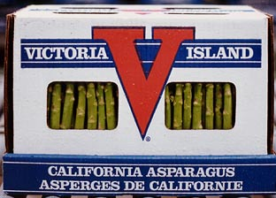
Packaging
Wholesalers and grocers look for “conventional” boxes
Sanitation and durability
Looking for traceability and function for packages down the road-GAP
Prefer ‘farm identification’ labels and packaging
Notes:
Conventional Boxes-earlier in the presentation you learned of some requirements from NY wholesale buyers. Sometimes these buyers specify what type of box they want the product to be in
Farm Identification-this gives the wholesaler an idea of where the product is coming from. Example: In Erie County NY the Buffalo Public Schools are sourcing more product locally. Instead of working directly with the farmer they have continued to buy from their distributor. Since the distributor requires farm id labels on their product they have been able to let the schools know what products are locally grown. This has given the opportunity for the school to provide information about the farm the produce is coming from to the students eating their lunches.

Slide 40
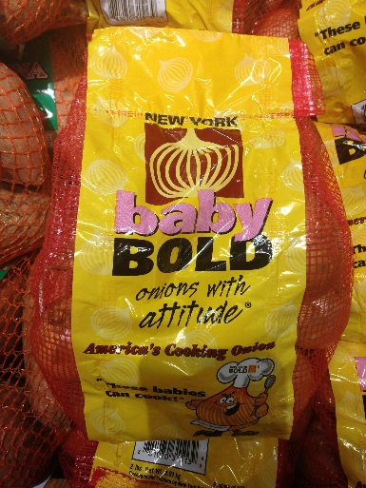



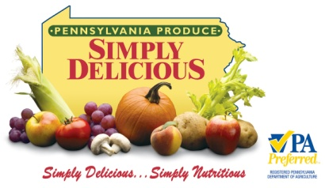
How Local is Local?
Farmer only farm markets
Production within ____ miles
State boundaries
Made in the USA?
Consumers increasingly care about food origin. Truth in advertising? Credibility for the ‘local’ brand
Picture Credit: PA Simply Delicious, Ohio Proud and Pick Tennessee
Notes:
Local means different things to different wholesale buyers. The buyers often base their “local” definition on distance.

Slide 41
Need to learn more about ‘local’ definitions and bounds
  Defining and Marketing ‘Local’ Foods:
Source: Batte et al., 2008.
Notes:
Todd Schmidt- Local Example of local definition

Slide 42
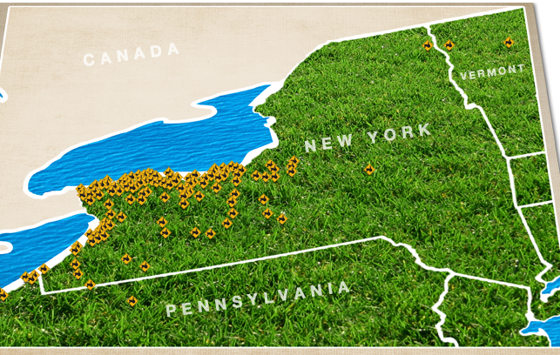
NY State “Local” examples
Walmart-Grown in NY State
Wegmans- 30-50 miles from store
Whole Foods-7 hours from one of their stores but they aim for 200miles
Tops-
Picture Credit: http://www.topsmarkets.com/Departments/Homegrown/#Map

Slide 43
Your Standard Packaging and Grading
Select Packaging
Most appropriate for your product
Economical
Choose Sale Unit
Weight
Other
Combination
Establish grading criteria
Size
Shape
Length
Specified by buyer?

Slide 44
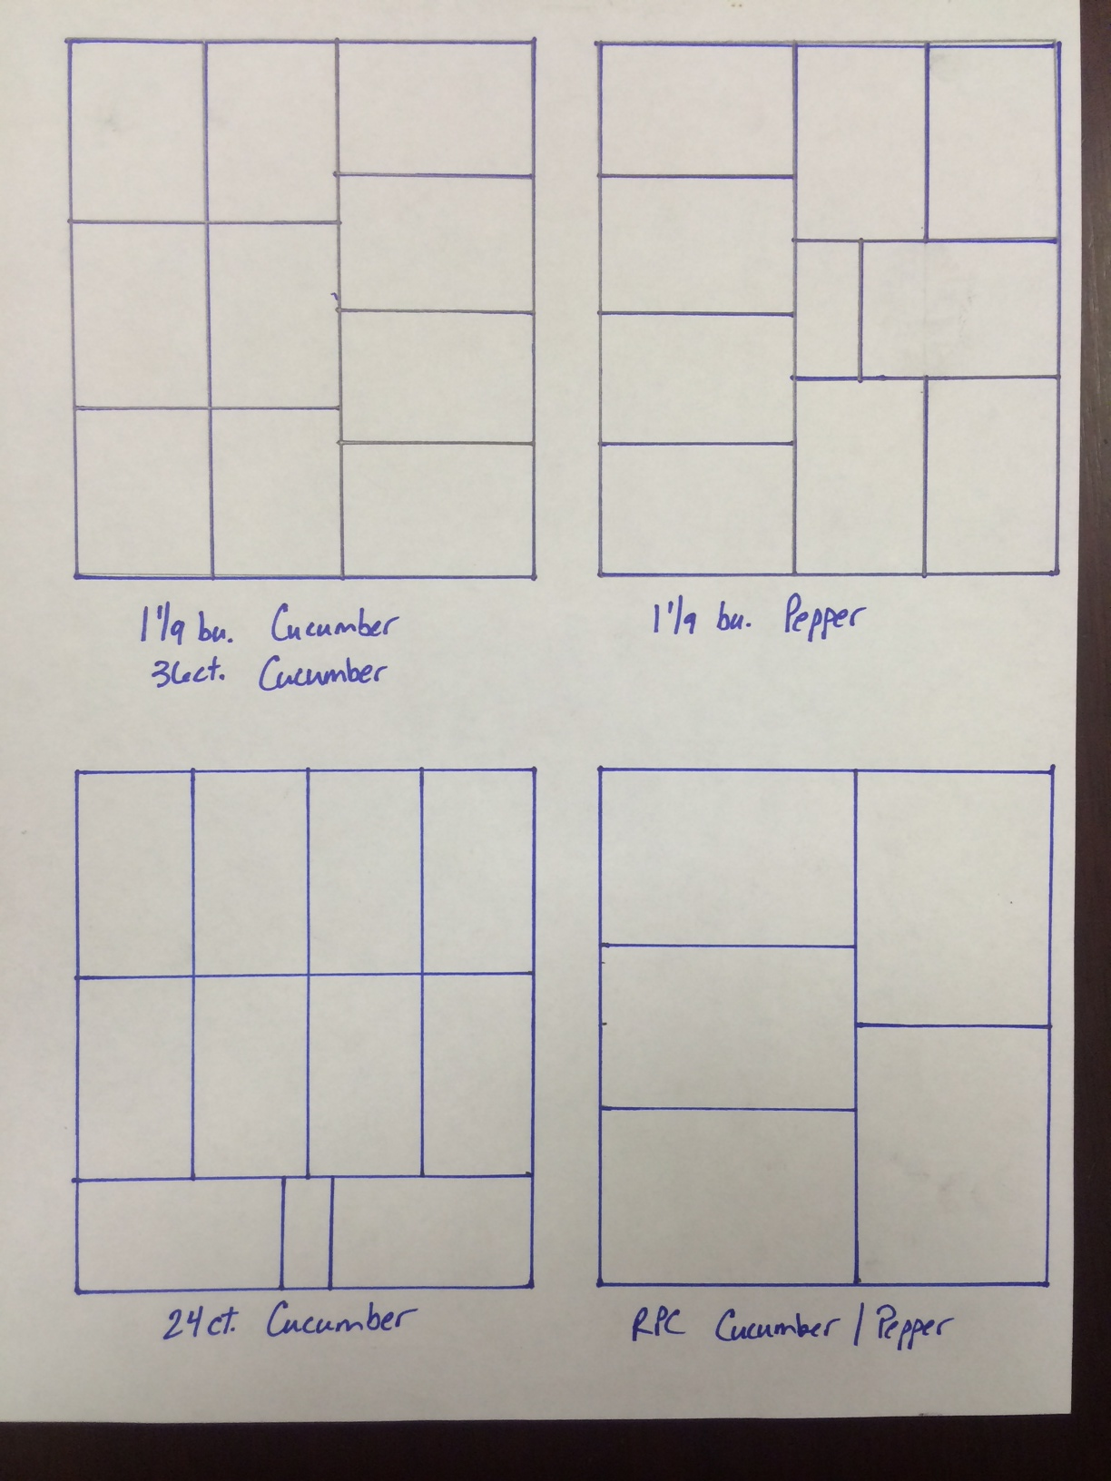
Pallet Stacking
For ease of shipping and to maintain quality wholesale buyers look for certain stack patters for different products. These are often associated with box size or product.
Pepper Example

Slide 45
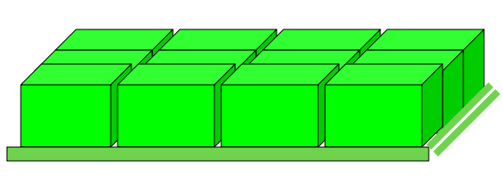
Pallet Stacking
Avoid Stacking patterns that may limit the ability of air flow to remove heat from products
  Vent holes in boxes
  Slightly looser stacking
  Helps pull cool air through the product
Source: http://mofarmtoschool.missouri.edu/files/packing.pdf
Notes:
Source: http://mofarmtoschool.missouri.edu/files/packing.pdf

Slide 46
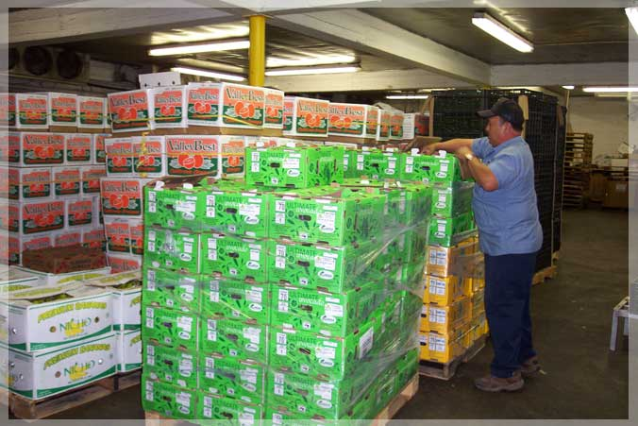
Good Stacking Job

Slide 47
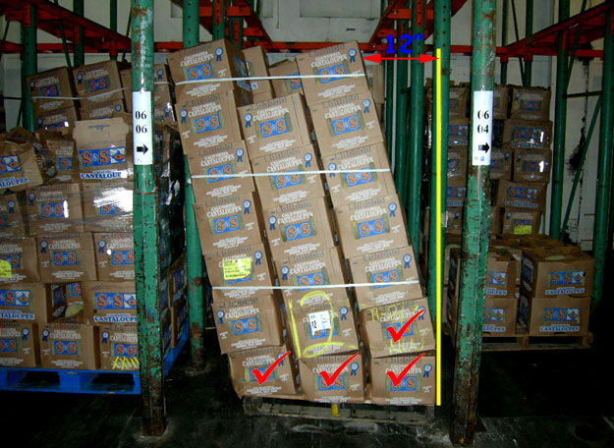
Bad stacking Job

Slide 48
Pallet Stacking Activity Option
For educator see resource on Pallet Stacking Activity for step by step instructions on how to do this activity

Slide 49
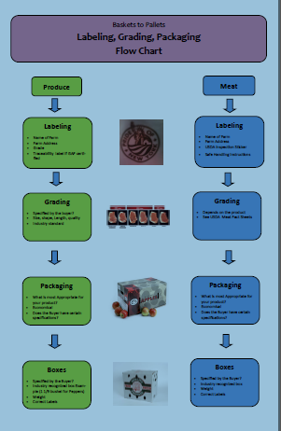
Review
Baskets to Pallets: Labeling, Grading and Packaging Flow Chart

Slide 50
Questions
Stick and Stone Farm
1234 Smallwood Road, Ithaca, NY 14853
PEP812

