Slide 1
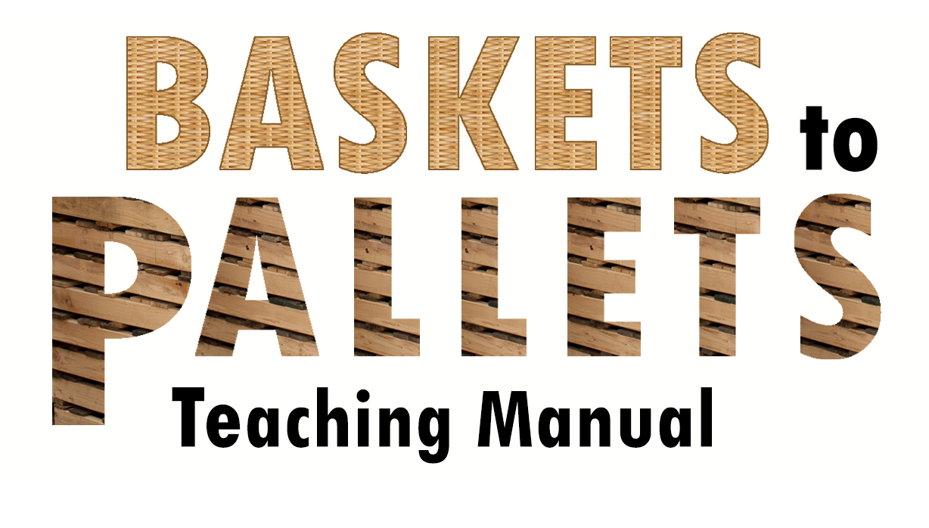
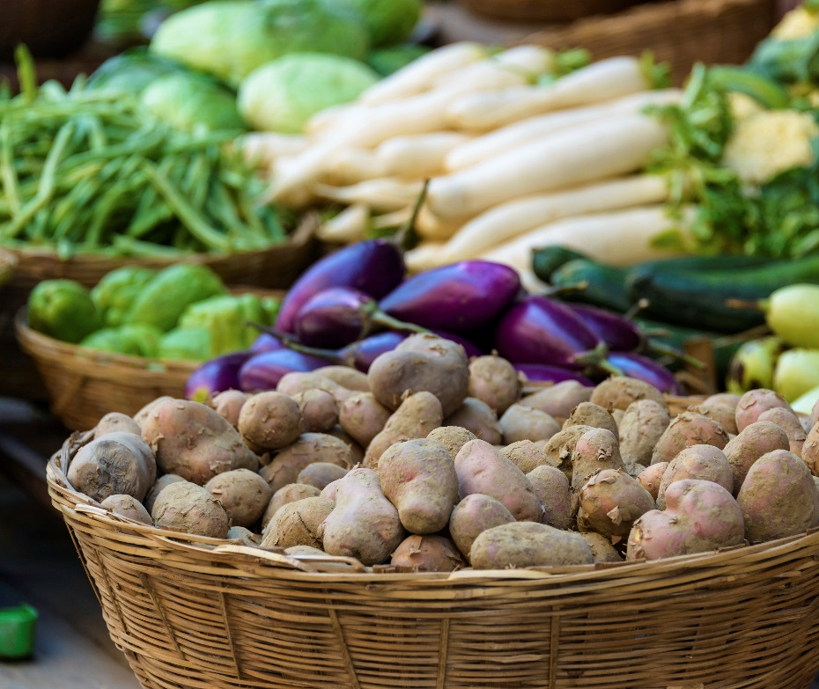
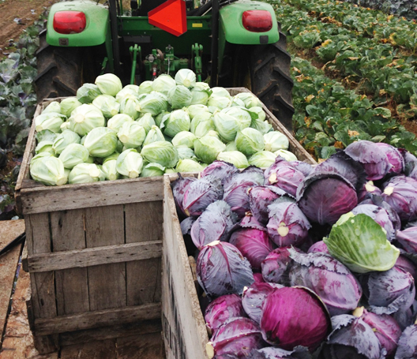
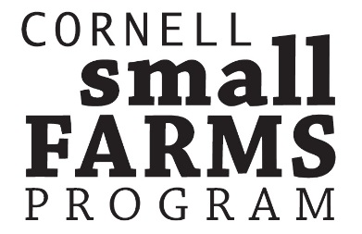
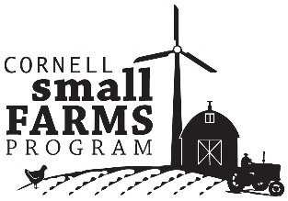


16 Lesson Plans to Prepare Small and Mid-scale
Farmers to Enter Food Hubs, Groceries, Restaurants and Cooperatives

Slide 2
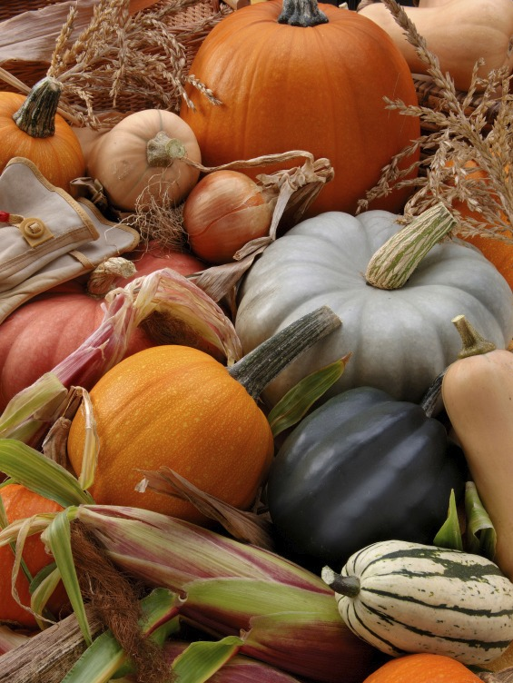
Module 4.1a
Uniformity, Consistency and Scheduling of Vegetable Crops
This powerpoint presentation is a companion resource to the ‘Baskets to Pallets Teaching Manual” available at smallfarms.cormell.edu
Please see ‘Module 4 – Production’ for additional teaching resources.
test

Slide 3
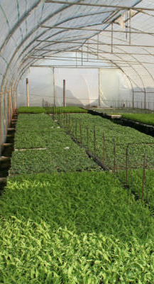
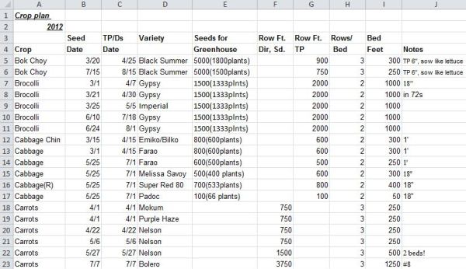
Consistency starts before planting
Images: (left) sutherlandseedlings.co.za (right) Rodale Institute
Notes:
Consistency starts with a good crop plan which allows for adequate harvest week after week
The plan needs to take into account which varieties are suitable at different points in the season, needs to include timely seeding and transplanting (if applicable)
Transplants need to consistently be of extremely high quality to maintain yields.

Slide 4
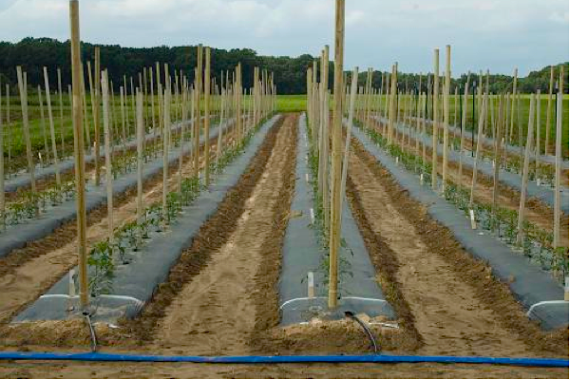
Cultural practices contribute to uniformity
Soil health and quality
Optimum fertility
  Pre-plant and in-season
Irrigation
Weed control
Pest control
Horticultural excellence
Image: Rutgers University
Notes:
Consistency and optimum yield relies heavily on best management practices. Crops need to be given the right environment to thrive; pruned, trained, and spaced properly for optimum growth; and protected from insect, disease and weed pressure.

Slide 5
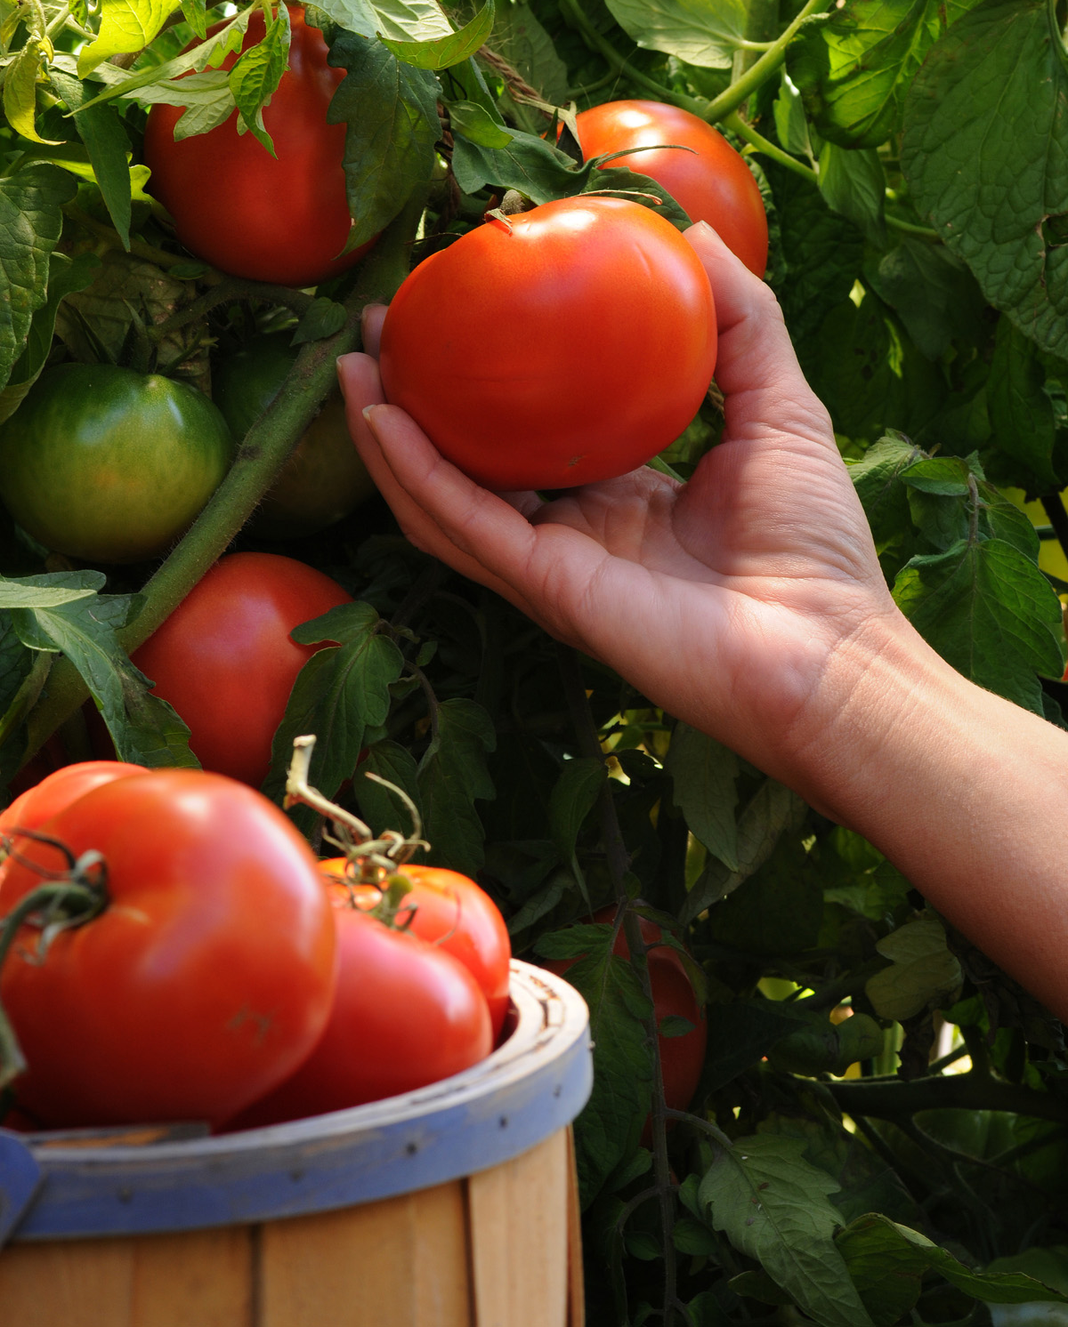
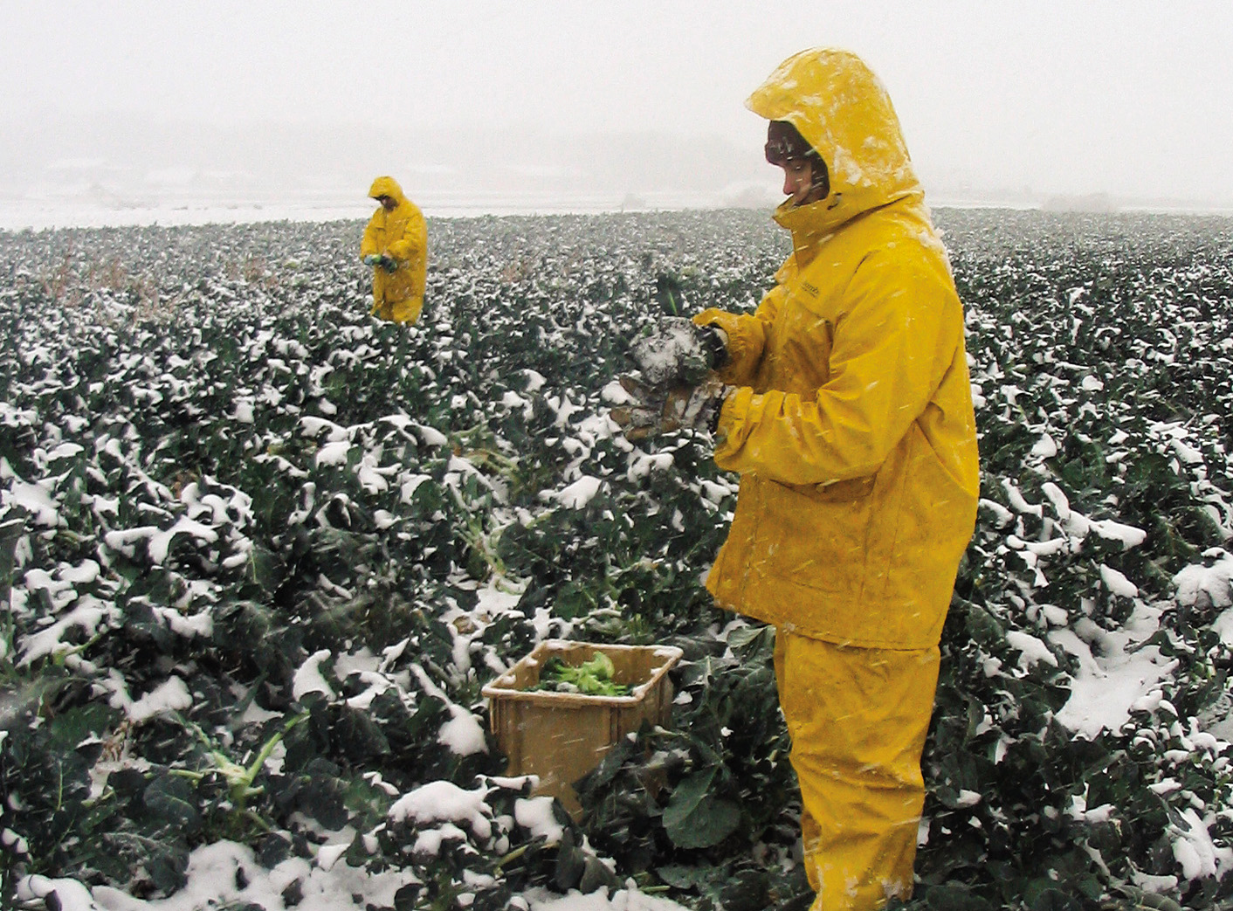
Fully understand (and meet) all your crops’ harvest needs
Image: Atina Diffley
Notes:
Wet crops: Fresh greens, broccoli, cabbage, cauliflower, green onions, sweet corn, roots with tops on.
Dry crops: All solanaceae, green beans, onions, winter squash, and garlic
Other topics of discussion: What is optimum harvest time for wholesale markets? Is it the same as when harvesting for retail?

Slide 6
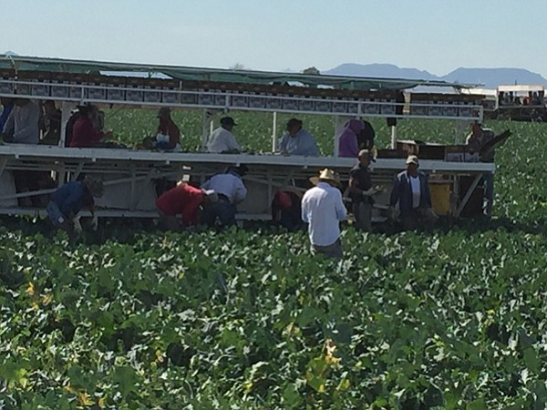
Harvest: Shelf life begins in the field
Maintain the cold chain for crops which require it
  Harvest early, when crops are cool
  Avoid direct sunlight
  Move crops to cooling facilities quickly and often
  Add example of small scale harvest
Image: kpbs.org
Notes:
One of the greatest expenses or areas of greatest quality loss comes in removing or failing to remove field heat. Harvesting early can reduce the temperature of crops by up to 20 degrees over later harvests.

Slide 7
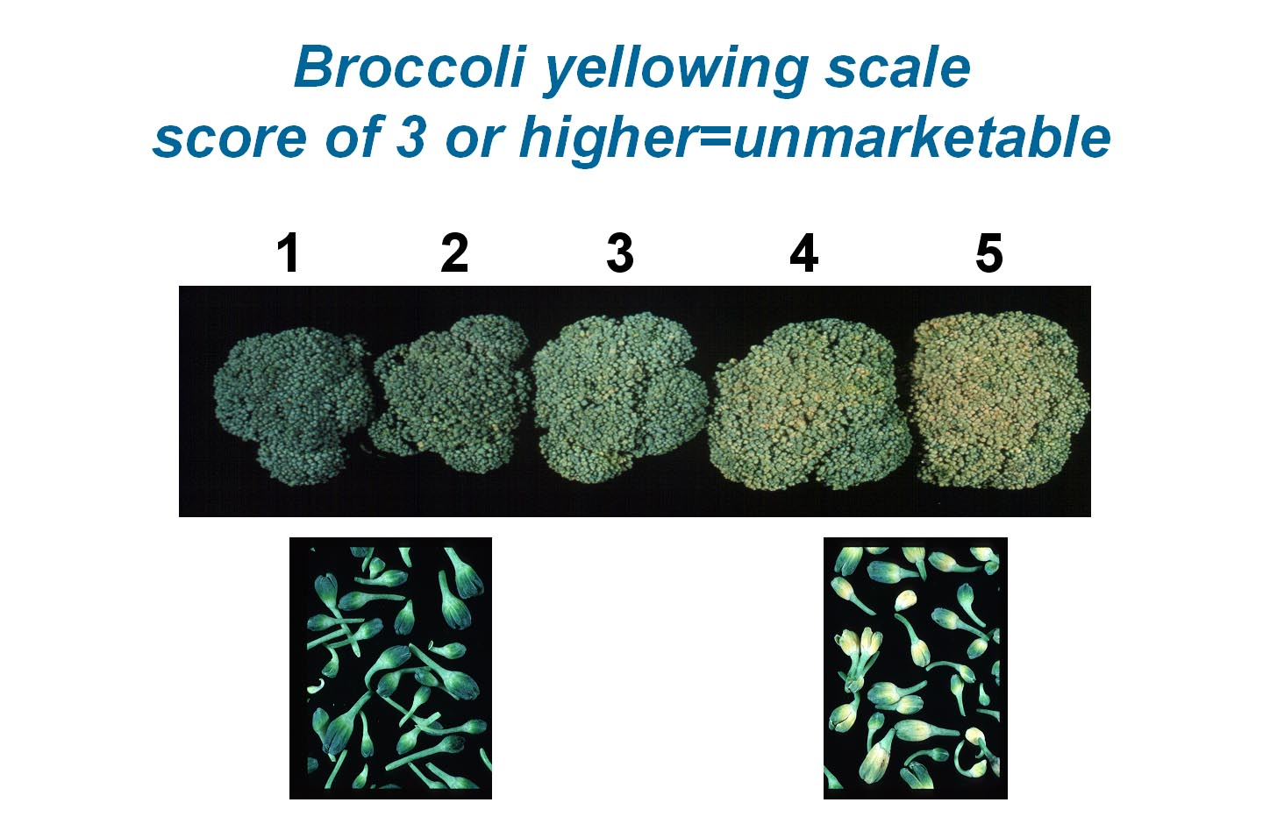
What happens when you don’t cool properly?
Image: UC Davis
Notes:
Loss of initial or longer-term quality
Dramatic loss in storability

Slide 8
Minimize handling, transport injury
Grade in the field and leave as much dirt there as possible
Harvest into totes which will minimize further handling—palletized or stackable totes
Smooth roads matter
Picture of grading here. A few pictures of harvest, cleaning, etc.

Slide 9
Cooling and Environment
Broccoli Storage Temperature | Max. Days of Marketability
32° Fahrenheit | 21-28 days
41° Fahrenheit | 14 days
50° Fahrenheit | 5 days
5° C, Air 5° C , Ethylene 10°C, Air
Source: UC Davis Postharvest Handling Factsheet for Broccoli. Cantwell.
Source: UC Davis Postharvest Handling Factsheet for Broccoli. Cantwell.
Notes:
Post-harvest cooling is one of the primary factors affecting the storability of crops. In order to deliver product which consistently stores its best (and is marketable as long as possible) proper cooling is essential.

Slide 10
Scheduling your deliveries:
Consider:
Buyer needs
Labor capacity of farm
Storage/infrastructure capacity of farm
Transportation capacity of farm
Notes:
All scheduling needs to take all factors into account, and to do so well in advance. Plan this part out fully before making a decision.

