Slide 1
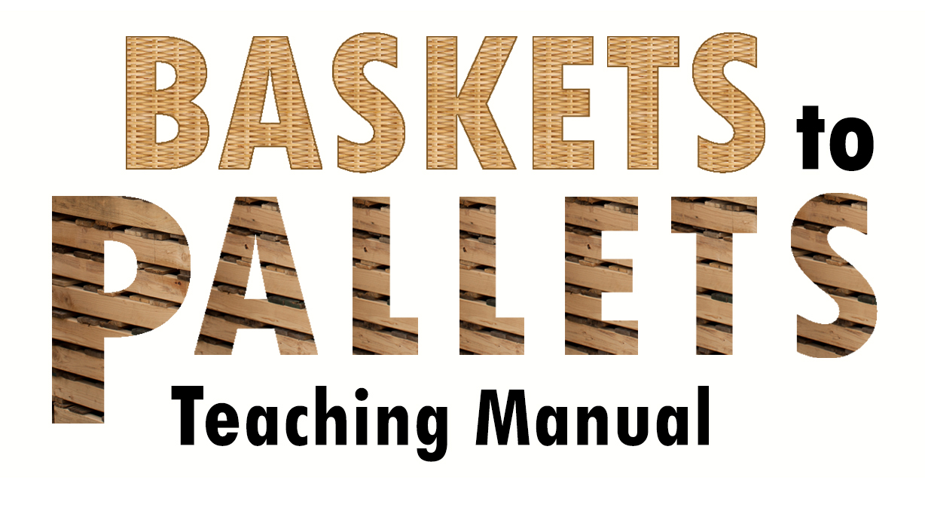
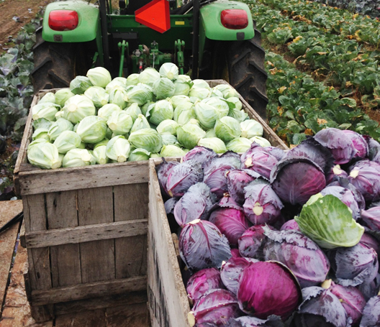
16 Lesson Plans to Prepare Small and Mid-scale
Farmers to Enter Food Hubs, Groceries, Restaurants and Cooperatives

Slide 2
Module 3.4 Making the Decision to Leap This powerpoint presentation is a companion resource to the ‘Baskets to Pallets Teaching Manual’ available at smallfarms.cornell.edu Please see ‘Module 3 – Business Management’ for additional teaching resources.
https://www.flickr.com/photos/rikkis_refuge/3557572093/in/photostream/
Notes:
There are many resources and ideas for developing a feasibility study. The presentation has been customized in the context of preparing a feasibility study for wholesale marketing.

Slide 3
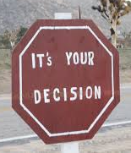
Making Decisions
How many decisions does the average adult make each day?
35,000!
http://go.roberts.edu/leadingedge/the-great-choices-of-strategic-leaders
Some easy
Some harder
https://www.flickr.com/photos/31034054@N04/3946702460
Notes:
The intent of this slide is to make participants aware that decision making is an everyday occurrence.
Show only the first bullet – “How many does the average adult make each day? Allow participants to offer guesses. Then show what research suggests how many are made in one day.
Some decisions are easy. Some are harder to make.

Slide 4
http://www.picserver.org/r/
Notes:
Risk vs Reward
Several factors influence how easy or hard a decision is to make. A decision that has high probability of a great reward with little risk will be fairly straight forward to make. A decision that has high reward, but greater risk will be harder to make. Can you live with the negative consequences if you guess wrong?

Slide 5
Notes:
To set the stage for discussion on decision making styles, ask the question of participants on how they make decisions. Are they able to share what factors/criteria they use to make a decision?

Slide 6
One Size Does Not Fit…..
We each have a “style”
Sequential
Logical
Global
Personable
Notes:
How we approach making a decision is influenced by our “decision making style.” There is not enough time to allow participants to learn about their predominant style, but could give them some time to start thinking about it. Appendix A contains the “My Decision-making Style” instrument.
The four styles are:
Sequential
Need lots of specific information, the details of what’s being asked, instructions on the best way of doing things, evidence that particular procedures work best, and steps for doing the task correctly.
Logical
Want the specifics, but more than that they want reasons, defensible positions, and a clear understanding of the possible results of the different choices.
Global
Want to explore all the possibilities. This process includes what exists as well as that which can be imagined. They need the specifics, but more than that they need a feeling of “fit,” of elegance, of an expanded and more inclusive view of what’s possible.
Personable
Need lots of specific information, good problem definitions, and the sharing of other people’s experiences. But even more than that they need to explore their own and other people’s feelings about the decision(s) being faced.

Slide 7
The Process
Notes:
Since different decisions may require different decision making process AND that we each have our own style, we use a different decision making process for each decision we make.
While time does not allow us to explore and share a wide variety of decision making tools, the next three slides display three different tools that can be used in slightly different decision making process.

Slide 8
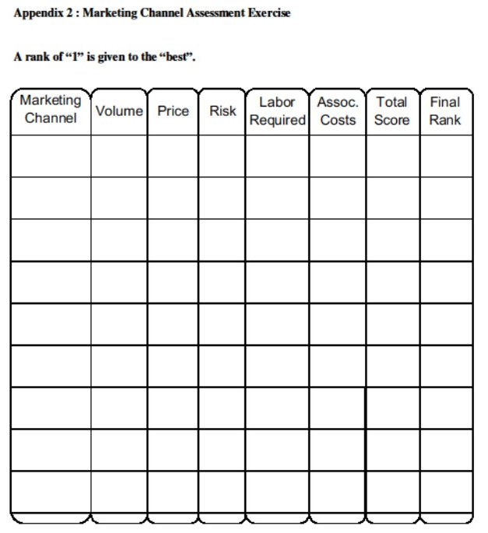
Notes:
This grid has been covered in another section (possibly) and shared here again to emphasize its utility in assisting in making a decision about market channels.
Ask the participants, what instances might they use this too to make a decision about marketing?

Slide 9
Notes:
This tool uses a more “qualitative” method to evaluate possible changes to the business. The proposed alternative is stated at the top. An example of how to start to use this decision making tool is included in the slide presentation.
The user then generates criteria (i.e., sell product to more wholesale customers) to evaluate the proposal.
There is space for the user to write down for the given criteria how the proposal supports (or is good for the business) the criteria in a favorable way.
They can also write down how the proposal does not support (or is not good for the business) the criteria in a favorable way.
Take a moment to field questions to make sure participants grasp how to use this decision making tool.

Slide 11
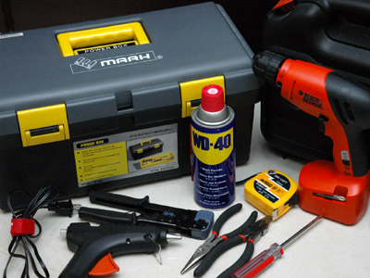
Summary
Risk vs Reward
Filling the Toolbox
One Size Does Not…..
https://www.google.com/imgres?imgurl=https://upload.wikimedia.org/wikipedia/commons/b/b3/Basic_DIY_Tools.jpg&imgrefurl=https://ja.wikipedia.org/wiki/DIY&h=300&w=400&tbnid=aQAUqfMVrHgjxM:&docid=e0fg4LSmv96R3M&ei=Bk--VsnpO8vW-QHypbKIBQ&tbm=isch&ved=0ahUKEwjJhPGKlvPKAhVLaz4KHfKSDFEQMwhSKCcwJw
Notes:
Need to gauge the risk vs reward of decisions will impact the time necessary to make a decision.
“Filling the Tool Box” - Attempted to give participants ideas on what they may be able to use to help them make a decision for their business.
One size does not fit all – there are various tools that can be used.
May want to mention that there are other tools that may assist them in making various decisions for their business. Appendix E contains a listing or pertinent decision making aides from Iowa State University.

