Slide 1
Taking Better
Farm Photos
John Suscovich
Farm Marketing Solutions

Slide 2

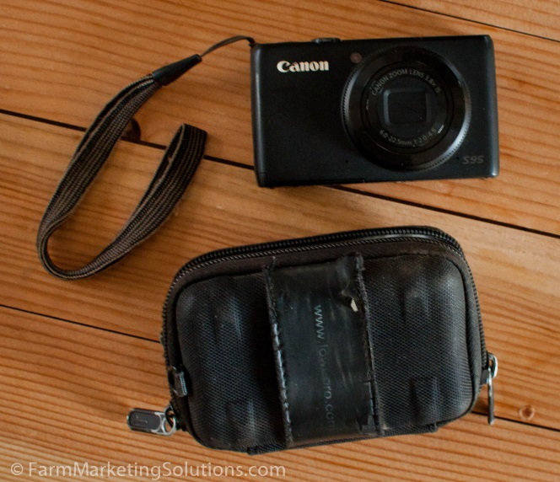
Necessary Equipment
Smart Phone
Point & Shoot Camera

Slide 3
F.A.R.T Before Taking a Photo
Feel
Ask
Refine
Take
KenRockwell.com

Slide 4
Feel
Walk around your farm until you feel like taking a photograph.
Look for inspiration.

Slide 5
Ask
Ask yourself why you are about to take a picture.
Quickly analyze what makes this particular situation interesting.
This will become second nature. It can be fun to inspect what makes things interesting, it also makes for better photos.

Slide 6
Refine
What specifically makes this photograph interesting?
Make THAT the focus of your image.
Is there another angle that could make it more interesting?
Get rid of anything that distracts from the main focus of the photo.

Slide 7
Take
Make sure the settings on your camera are set to capture the image the way you see it.
Take a few photos. Digital photos are easy to edit, organize, and delete. You only kick yourself for the pictures you don’t take.

Slide 8
3 Things You Can Concentrate on Right Now to Take Better Photos
Framing
Interest
Lighting

Slide 9
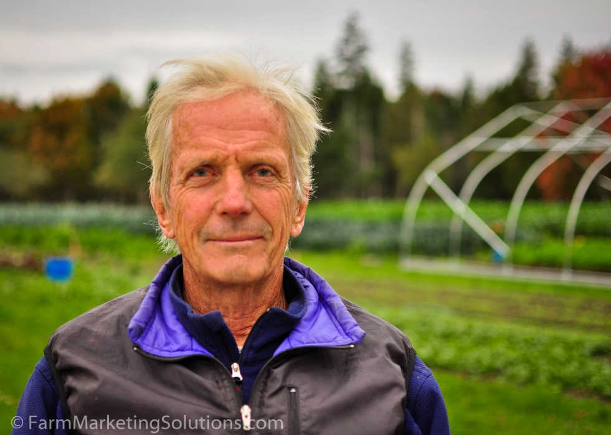
Framing

Slide 10

Rule of Thirds

Slide 11
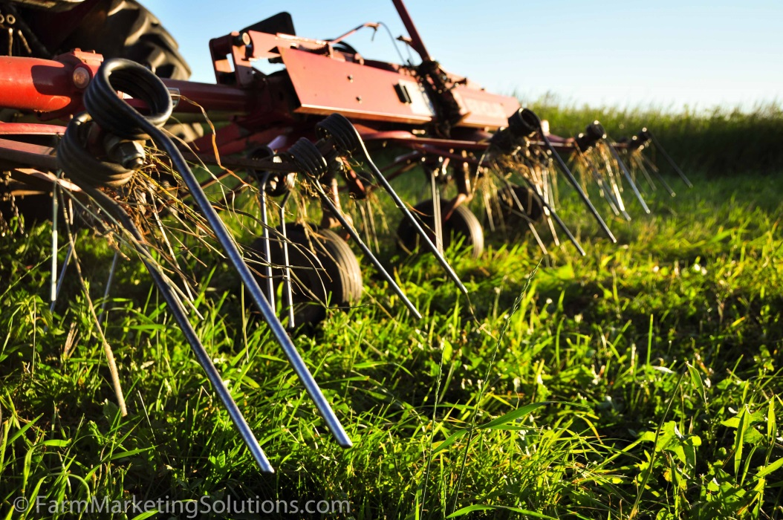
Interest

Slide 12
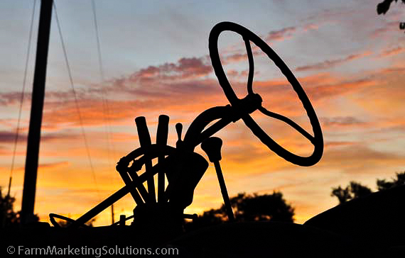
Lighting

Slide 13
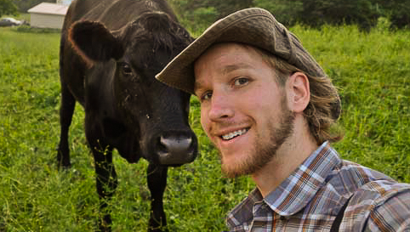
FarmMarketingSolutions.com
John Suscovich

